Slide 1
Usable Security and Privacy (CS60081)
Autumn 2026-27
Shamik Sural
Lecture 4: Access Control shamik@cse.iitkgp.ac.in/shamik.sural@gmail.com

Slide 2
Security Models
Access Control Fundamentals
Security Models/Policies
  Discretionary Access Control (DAC)
  Mandatory Access Control (MAC)
  Chinese Wall Security Policy
  Role-based Access Control (RBAC)
  Attribute-based Access Control (ABAC)

Slide 3
Access Control - Basic Concepts
An access control system
  regulates the operations that can be executed on data and resources to be protected
  Its goal is to control operations executed by subjects in order to prevent actions that could damage data and resources
Access control is typically provided as part of the operating system and of the database management system (DBMS)
A conceptual security model
  provides means to describe the protection needs of an organization
  provides a description of the system behavior
  proves that the system satisfies some safety properties
Access control categories
  Discretionary Access Control
  Mandatory Access Control
  Beyond DAC and MAC

Slide 4
Access Control Mechanism
It is typically a software system implementing the access control function
It is usually part of OS/DBMS/Application software
It uses specified access control policies to decide whether to grant or deny a subject access to a requested resource

Slide 5
Access Control Principles
In a broad sense, all of computer security is concerned with access control
RFC 4949 defines computer security as:
“measures that implement and assure security services in a computer system, particularly those that assure access control service”

Slide 6
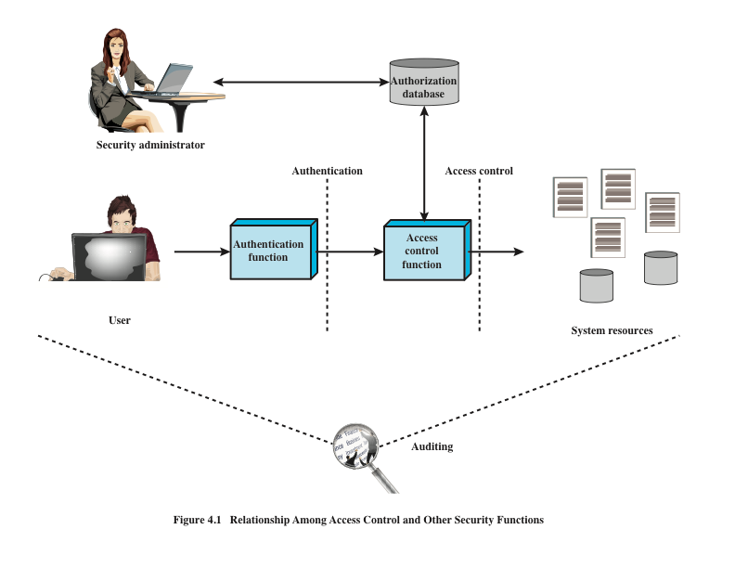
Source: Based on [SAND94].

Slide 7
Subjects, Objects, and Access Rights
Subject
An entity capable of accessing objects
Three classes
Owner
Group
World
Object
A resource to which access is controlled
Entity used to contain and/or receive information
Access right
Describes the way in which a subject may access an object
Could include:
Read
Write
Execute
Delete
Create
Search

Slide 8
Access Control - Basic Concepts
Subject
Access
request
Reference
monitor
Object
The fundamental and simple notion of access control (Lampson)
  Suggests that there is an active subject requiring access to a passive
  object to perform some specific operation.
  A reference monitor grants or denies access

Slide 9
Access Control Policies
Discretionary access control (DAC)
  Controls access based on the identity of the requestor and on access rules (authorizations) stating what requestors are (or are not) allowed to do
Mandatory access control (MAC)
  Controls access based on comparing security labels with security clearances
Role-based access control (RBAC)
  Controls access based on the roles that users have within the system and on rules stating what accesses are allowed to users in given roles
Attribute-based access control (ABAC)
  Controls access based on attributes of the user, the resource to be accessed, and current environmental conditions

Slide 10
Discretionary Access Control (DAC)
Scheme in which an entity may be granted access rights that permit the entity, by its own violation, to enable another entity to access some resource
  Often provided using an access matrix
      One dimension consists of identified subjects that may attempt data access to the resources
      The other dimension lists the objects that may be accessed
  Each entry in the matrix indicates the access rights of a particular subject for a particular object

Slide 11
Discretionary Access Control
Mechanisms are discretionary in that they allow subjects to grant other subjects authorization to access their objects at their discretion
  Users can protect what they own
  Owner may grant access to other users
  Allows access rights to be propagated from one subject to another (Possession of an access right by a subject is sufficient to allow access to the object)
Govern the access of subjects to objects on the basis of subjects' identity, objects’ identity and permissions
Access request is submitted to the system, the access control mechanism verifies whether there is a permission authorizing the access
Suitable for most commercial systems
The mechanisms are adequate for most honest users but cannot withstand sophisticated attacks from malicious users (for example, vulnerable to Trojan Horse attacks)

Slide 13
Access Control Matrix Model
Basic Abstractions
  Subjects
  Objects
  Rights
The rights in a cell specify the access of the subject (row) to the object (column)
S u b j e c t s and O b j e c t s
s
u
b
j
e
c
t
s
F
U
r,w,own
V
rights

Slide 14
Propagation of Access - Total Discretion
S u b j e c t s and O b j e c t s
s
u
b
j
e
c
t
s
F
U
r,w,own
V
r
rights

Slide 15
Propagation of Access - Copy Flag
S u b j e c t s and O b j e c t s
s
u
b
j
e
c
t
s
F
U
rc, wc, own
V
rc
W
r

Slide 16
Propagation of Access - Constrained Discretion
S u b j e c t s and O b j e c t s
s
u
b
j
e
c
t
s
F
V
W
U
rc
,
g
V
W
S u b j e c t s and O b j e c t s
s
u
b
j
e
c
t
s
F
V
W
U
rc
g
V
r
W

Slide 17
Model Implementation
Access Control List (ACL)
Capability list
A relation

Slide 18
Access Control Structures
Access Control Matrix.
- S: set of subjects
- O: set of objects
- A:set of access modes
An access control matrix M on S, O, and A is defined as
M = (M_{so})_{s ∈ S, o∈ O} with M_{so} ⊂ A
The entry M_{so} specifies the set of access operations subject s can perform on object o.
 | bill.doc | edit.exe | fun.dir
Alice | - | {execute} | {execute, read}
Bill | {read, write} | - | {execute, read, write}

Slide 19
Access Control Structures
Access Control Lists and Capabilities
Directly implementing access control matrices is quite inefficient, because in most cases these matrices are sparse
Therefore two main implementations have been developed
  Access control lists
    Used in DBMS and Operating Systems
  Capability Lists

Slide 20
Access Control Lists
F
G
U:r
V:r
V:w
V:own
U:r
U:w
U:own
Each column of the matrix is stored with the object
corresponding to that column
Expensive to find the list of all objects that can be accessed by a specific subject

Slide 21
Capability Lists
Each column of the access matrix is stored with the objects corresponding to that column
Expensive to find the list of all subjects who can gain access to a specific object
U F/r, F/w, F/own, G/r
V G/r, G/w, G/own

Slide 22
Relations
  A table with fields
  Not possible to store in main memory because number of subjects(objects) is typically large
  Inefficient to store privileges on public documents
  Can find neither all the objects that can be accessed by a subject, nor all subjects that are allowed to access an object
Subject Access Object
U r F
U w F
U own F
U r G
V r G
V w G
V own G

Slide 23
ACLs versus Capabilities
Access Review and Revocation
  ACLs provide for superior access review and revocation on a per-object basis
  Capabilities provide for superior access review and revocation on a per-subject basis
The per-object basis usually wins out so most operating systems protect files by means of ACLs
Many operating systems use an abbreviated form of ACLs with just three entries
  owner
  group
  other

Slide 24
UNIX File Access Control
UNIX files are administered using inodes (index nodes)
Control structures with key information needed for a particular file
Several file names may be associated with a single inode
An active inode is associated with exactly one file
File attributes, permissions and control information are sorted in the inode
On the disk there is an inode table, or inode list, that contains the inodes of all the files in the file system
When a file is opened its inode is brought into main memory and stored in a memory resident inode table
Directories are structured in a hierarchical tree
May contain files and/or other directories
Contains file names plus pointers to associated inodes

Slide 25
DAC
Advantages:
  Flexibility in terms of policy specification
  Supported by all OS and DBMS
Inherent Weaknesses of DAC:
  No information flow control
  Unrestricted DAC allows information from an object which can be read by a subject to be written to any other object
  Suppose our users are trusted not to do this deliberately. It is still possible for Trojan Horses to copy information from one object to another.
  A Trojan Horse is rogue software installed, perhaps unwittingly, by duly authorized users
  A Trojan Horse does what a user expects it to do, but in addition exploits the user's legitimate privileges to cause a security breach

Slide 26
Mandatory Access Control
Mandatory access controls (MAC) restrict the access of subjects to objects on the basis of security labels
Assign security level to all data
Assign security clearance to each user
The system must make sure that all users have access to only those data for which they have a clearance

Slide 27
The Military Lattice
Hierarchical Classes
Categories and Compartments
{ARMY, NUCLEAR, CRYPTO}
{ARMY, NUCLEAR} {ARMY,CRYPTO} {NUCLEAR,CRYPTO}
{ARMY} {NUCLEAR} {CRYPTO}
    { }
Top Secret
Secret
Confidential
Unclassified

Slide 28
Lattice Structures
Hierarchical Classes
Categories and Compartments
TS
{A,B}
S
{A}
{B}
{ }
TS, {A,B}
Hierarchical Classes
with compartments
TS, {A}
TS, {B}
TS, {}
S, {A,B}
S, {A}
S, {B}
S, {}

Slide 29
Lattice Models
Bell-LaPadula Model
  Stated in terms of subjects and objects
  Every object is assigned a classification and every subject a clearance
  Classification and Clearance (denoted as L) both are comprised of hierarchical classes and compartments mentioned in the previous slides
  BLP consists of two properties
    simple security property - A subject S is allowed to read an object O if L(S) is greater than or equal to L(O) (no read up)
    *-property - S is allowed to write O if L(S) less than or equal to L(O) (no write down)
    Here greater and lesser are defined in terms of the “dominates” rule.
Why *-property?
  Recall the Trojan Horse Example

Slide 30
Bell-LaPadula Model
Example
  John has the clearance L(J) = <TS,{B}>
  Harry has the clearance L(H) = <S,{A,B}>
  File F1 has the classification L(F1) = <S, {A}>
  File F2 has the classification L(F2) = <S, {B}>
Which subject can read and write which object?

Slide 31
Applications of BLP
Not limited to military environment, but appears in other domains as well
  medical employees have the right to view patient records but cannot pass this right to non-medical employees
  advisors cannot pass the right to look at student grades to other students
  payroll officers cannot pass the right to look at employee salaries to other employees

Slide 32
Lattice Model for Integrity
Biba Model
  Dual of Bell-LaPadula Security Model
  An integrity level consists of two components: a classification and a category
    Crucial (C), Very Important (VI) and Important (I)
  Consists of two properties
    simple integrity property - A subject S is allowed to read an object O if L(S) is less than or equal to L(O) (no read down)
    *-property - S is allowed to write O if L(S) greater than or equal to L(O) (no write up)

Slide 33
Chinese Wall Policy
Introduced by Brewer and Nash in 1989
The motivation for this work was to avoid that sensitive information concerning a company be disclosed to competitor companies through the work of financial consultants
It dynamically establishes the access rights of a user based on what the user has already accessed

Slide 34
Chinese Wall Policy
A mixture of free choice and mandatory controls
Requires some kind of dynamic labeling
Requires clear distinction between user labels and subject labels (Brewer and Nash have not done this; later done by Sandhu 1992)
All objects
COI classes
Company datasets
Individual objects

Slide 35
Chinese Wall Policy
Subjects: Active entities accessing protected objects
Objects: Data organized according to 3 levels
        Information
        DataSet
        Conflict-of-Interest (CoI) classes
Access Rules
        Read rule
        Write rule

Slide 36
Conflict of Interest
It is a well known concept
An example in the financial world
  Consider a market analyst working for a financial institution providing corporate business services
  This analyst must uphold the confidentiality of information provided to him by his firm’s client
  this means he/she cannot advise corporations where he/she has insider knowledge of the plans, status and standing of a competitor
  However the analyst is free to advice corporations which are not in competition with each other, and also to draw on general market information

Slide 37
Conflict of Interest Groups
Set of All Objects
CoI 1
CoI 2
CoI 3
Bank A
Bank B
Gas A
Oil A
Oil B
Info
Info
Info
Info
Info
Info
Info
Info
Info

Slide 38
Conflict of Interest Groups
Set of All Objects
CoI 1
CoI 2
CoI 3
Delta
United
Continental
Hertz
Avis
Hilton
Marriot
Info
Info
Info
Info
Info
Info
Info
Info
Info

Slide 39
Restrictions of Chinese Wall Policy
Read Access (Simple Security Property)
  A subject S can read an object O only if
    O is in the same company dataset as some object previously read by S (i.e., O is within the wall)
    or
    O belongs to a conflict of interest class within which S has not read any object (i.e., O is in the open)
Write Access (*-Property)
  A subject S can write an object O only if
    S can read O by the simple security rule
    and
    no object can be read which is in a different company dataset of the one for which write access is requested

Slide 40
Read Rule
Discretionary access
Mandatory denial
consultant
R
X
R
Bank A
Bank B
R
R
R
Insurance
Oil B

Slide 41
Read Rule
= Alice
Set of All Objects
COI 1
CoI 2
COI 3
CoI 1
CoI 3
Bank A
Bank A
Bank B
Gas A
Oil A
Oil B
Oil A
Info
Info
Info
Info
Info
Info
Info
Info
Info
Info
Info

Slide 42
Write Rule
The Read Rule does not prevent indirect flow of information
Consider the following case:
  Alice has access to
    Oil A and Bank A
  Bob has access to
    Oil B and Bank A
  If Alice is allowed to read Oil A and write into Bank A, it may transfer information about Oil A that can then be read by Bob

Slide 43
Write Rule
S can write O only if
  S can read O by BN Read rule
  no object can be read which is in the different company set to the one for which write access is requested
Consultant
A
W
X
Oil A
R
Bank A
Consultant
B
Oil B
R
W

Slide 44
Write Rule
= Alice
Set of all objects
COI 1
CoI 2
COI 3
CoI 1
CoI 3
Bank A
Bank A
Gas A
Oil A
Oil A
Info
Info
Info
ABC
Info
Info
Info
ABC
Info

Slide 45
Write Rule
Set of all objects
= Bob
COI 1
COI 2
COI 3
COI 1
COI 3
Bank B
Gas A
Oil A
Bank B
Oil A
Info
Info
Info
Info
ABC
Info
ABC
Info

Slide 46
Write Rule
Thus, according to the write rule:
  The flow of information is confined to its own company dataset

Slide 47
Remarks on the Chinese wall Policy
Implications of the *-property:
  either
    S cannot write at all
  or
    S is limited to reading and writing one company dataset
Can be modeled as a lattice

Slide 48
Comparison with Bell-LaPadula
The Chinese Wall Policy is a combination of free choice and mandatory control
Initially a subject is free to access any object it wishes
Once the initial choice is made, a Chinese Wall is created for that user around the dataset to which the object belongs
Note also that a Chinese Wall can be combined with DAC policies

Slide 49
Criticisms to the Model
The Write Rule of BN is very restrictive:
A user that has read objects from more than one dataset is not able to write any object
The user can only read and write objects from a single dataset

Slide 50
Role Based Access Control (RBAC)
Large organizations ➔large number of users, large number of objects ➔ large number of authorizations
  Security administration is challenging
Whenever there is a change in users
  Authorizations must be granted/revoked
RBAC attempts to simply this
Users do not own the objects
Access is determined by the job function of the users rather than data ownership
RBAC is an alternative policy to DAC and MAC
Advantages
  simplifies the task of access control management
  directly supports function-based access control

Slide 51
RBAC
Roles
  Represent job functions within an organization
Authorizations are granted to roles rather than to users
Users in turn are assigned to roles
While users may change frequently, roles are more static
DBMS vendors have recognized the importance and the advantages of RBAC
Almost all commercial DBMSs support features of RBAC to certain extent
There is some consensus on a standard RBAC model
  The NIST model [Sandhu,Ferraiolo,Kuhn 2000] has been the first step towards the definition of a standard

Slide 52
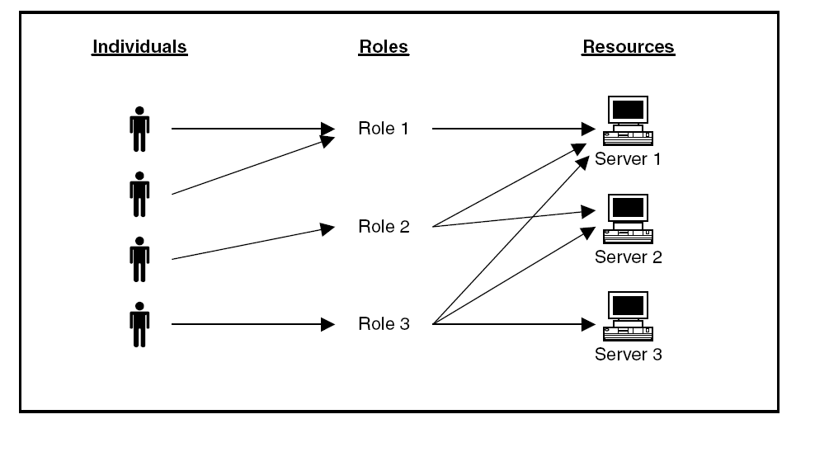
Role-Based Access Control

Slide 53
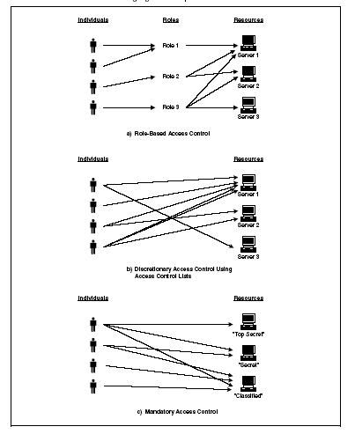

Slide 54
RBAC: Benefits
Because roles represent organizational functions, an RBAC model can directly support security policies of the organization
Granting and revoking of user authorizations is greatly simplified
RBAC models have been shown to be policy-neutral

Slide 55
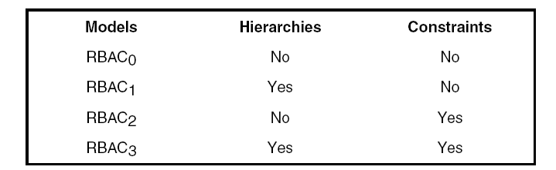
The NIST Model
Three levels
  Core RBAC
  Hierarchical RBAC
  Constrained RBAC

Slide 58
RBAC- Basic concepts
User
  is defined as a human being, a machine, a process, or an intelligent autonomous agent, etc.
Role
  is a function within the context of an organization with an associated semantics regarding its authority and responsibility
Permission
  is an access mode that can be exercised on objects in the system.
  Both objects and access modes are domain dependent.
  For example, in the case of databases, the object set includes tables, columns, and rows, and the access mode set includes insert, delete, and update operations.

Slide 59
RBAC- Basic concepts
Session
  it is a particular instance of a connection of a user to the system and defines the subset of activated roles.
  At each time instant, different sessions for the same user can be active.
  When a user logs in the system, he/she establishes a session and, during this session, can request to activate a subset of the roles he/she is authorized to play.
  The user obtains all permissions associated with the role he/she has activated in the session

Slide 60
Core RBAC

Slide 61
Core RBAC - Sessions
The notion of session is quite abstract – it is defined as “a mapping between a user and an activated subset of roles that are assigned to the user”
Basic distinction:
  Single-role activation (SRA) Only one role can be activated
  Multi-role activation (MRA) Multiple roles can be activated in one session, and dynamic separation of duty constraints may be used to restrict concurrent activation of some roles
  There are trade-offs between the use of these two types of session

Slide 62
Core RBAC - Permissions
RA
PA
Operations
Objects
Users
Roles
UA
Permissions
RSA
Sessions

Slide 63
Hierarchical RBAC
Role hierarchies
Role hierarchies are a natural means for structuring roles to reflect an organization’s line of authority and responsibility
Higher level roles inherit permissions of lower level roles

Slide 65
Constraints - RBAC
Provide a means of adapting RBAC to the specifics of administrative and security policies of an organization
A defined relationship among roles or a condition related to roles
Types:
Mutually exclusive roles
A user can only be assigned to one role in the set (either during a session or statically)
Any permission (access right) can be granted to only one role in the set
Cardinality
Setting a maximum number with respect to roles
Prerequisite roles
Dictates that a user can only be assigned to a particular role if it is already assigned to some other specified role

Slide 66
Constrained RBAC
Separation of Duties (SOD) Constraints
  To mitigate the fraud
  Enforce conflict of interest policies employed to prevent users from exceeding a reasonable level of authority for their position.
  Ensure that failures of omission or commission within an organization can be caused only as a result of collusion among individuals.
Two Types
  Static SoD
  Dynamic SoD
Examples
  At least two individuals are needed to open a locker
  A user who prepares a check cannot issue the check
  A user cannot play two roles simultaneously

Slide 67
RBAC – Static SoD Constraints
SSoD places restrictions on the set of roles and in particular on their ability to form RA relations.
No user is assigned to t or more roles in a set of m roles
Prevents a person being authorized to use too many roles
These constraints can be enforced based on the users assigned to each role

Slide 68
RBAC – Dynamic SoD Constraints
These constraints limit the number of roles a user can activate in a single session
Examples of constraints:
  No user may activate t or more roles from the roles set in each user session.
  If a user has used role r1 in a session, he/she cannot use role r2 in the same session
Enforcement of these roles requires keeping the history of the user access to roles within a session

Slide 69
Why Yet Another Access Control Model
Inability to handle context like date and time of access, server load, etc.
Fine grained access control
Ad hoc access to new users
Bringing most of the existing models to a common model

Slide 70
Attribute-Based Access Control (ABAC)
Can define authorizations that express conditions on properties of both the resource and the subject
Strength is its flexibility and expressive power
Main obstacle to its adoption in real systems has been concern about the performance impact of evaluating predicates on both resource and user properties for each access
Web services have been pioneering technologies through the introduction of the eXtensible Access Control Markup Language (XACML)
There is considerable interest in applying the model to cloud services

Slide 71
Attribute-Based Access Control (ABAC)
Based on the notion of attributes
Attributes are characteristics of user, object and environment
Each entity is associated with a set of well-defined attributes
Each attribute can assume one or more possible values
                For example, a user u₁ can have the value professor for the user attribute designation and the value CS for the user attribute department

Slide 72
Components of ABAC
User (U)
  Entities that request for access to resource
  u₁, u₂, u₃, u₄
Object (O)
  Resources to be protected from unauthorized access
  o₁, o₂, o₃, o₄
Environmental Condition (E)
  Context in which access requests are made
  e₁, e₂
Operation (OP)
  Activities performed by users on objects
  read, write, execute, print

Slide 73
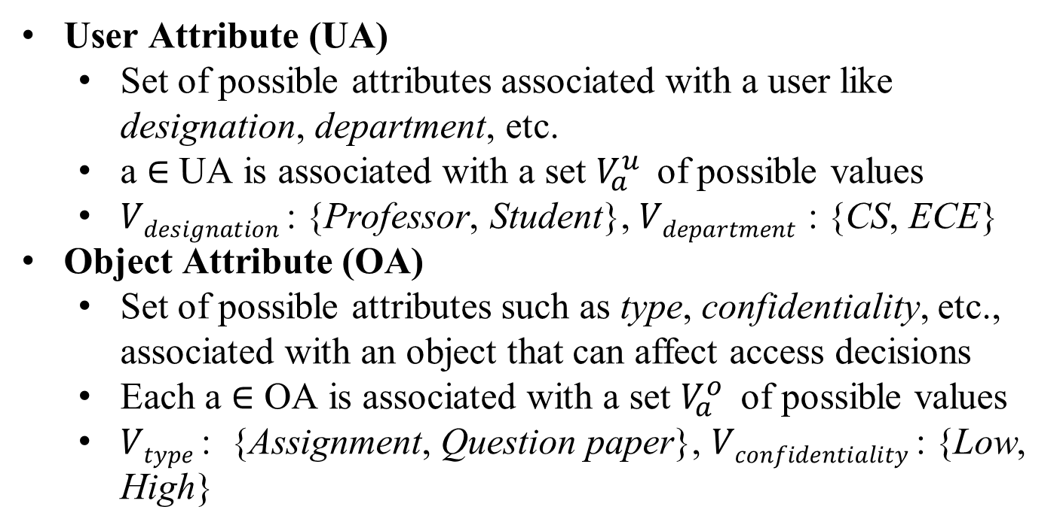
Components of ABAC
User Attribute (UA)
  Set of possible attributes associated with a user like designation, department, etc.
  a ∈ UA is associated with a set $V_{a}^{u }$ of possible values
  $Vdesignation$: {Professor, Student}, $Vdepartment$ : {CS, ECE}
Object Attribute (OA)
  Set of possible attributes such as type, confidentiality, etc., associated with an object that can affect access decisions
  Each a ∈ OA is associated with a set $V_{a}^{o }$ of possible values
  $Vtype$: {Assignment, Question paper}, $Vconfidentiality$: {Low, High}

Slide 74
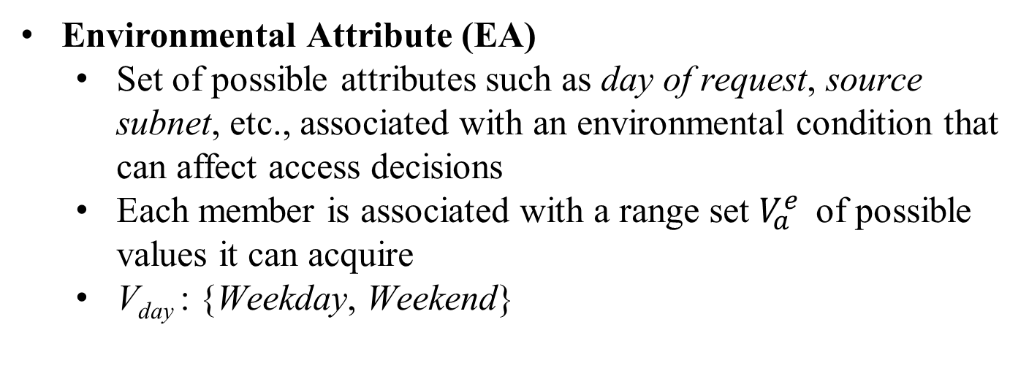
Components of ABAC
Environmental Attribute (EA)
  Set of possible attributes such as day of request, source subnet, etc., associated with an environmental condition that can affect access decisions
  Each member is associated with a range set $V_{a}^{e }$ of possible values it can acquire
  V_{day} : {Weekday, Weekend}

Slide 75
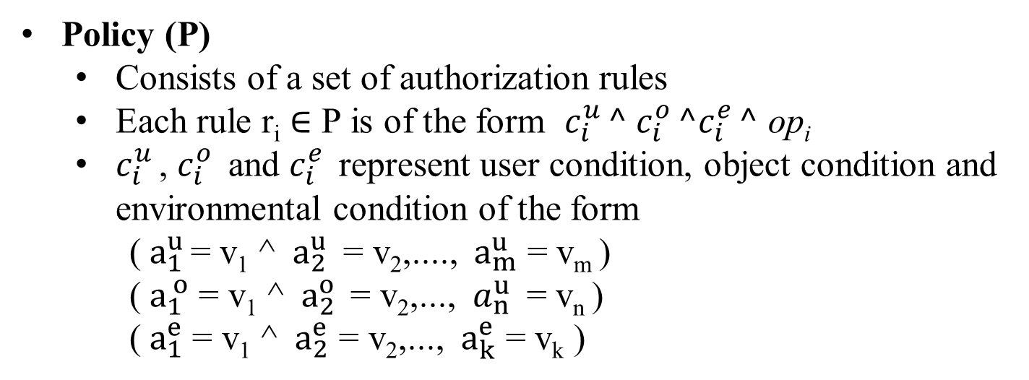
Components of ABAC
Policy (P)
  Consists of a set of authorization rules
  Each rule r_{i} ∈ P is of the form $c_{i}^{u }^$ $c_{i}^{o }^c_{i}^{e }^$ op_{i}
  $c_{i}^{u }$, $c_{i}^{o }$ and $c_{i}^{e }$ represent user condition, object condition and environmental condition of the form
  (${ a}_{1}^{u }$= v₁ ^ ${ a}_{2}^{u }$ = v₂,...., ${ a}_{m}^{u }$ = v_{m} )
  (${ a}_{1}^{ o}$ = v₁ ^ ${ a}_{2}^{o }$ = v₂,..., ${ a}_{n}^{u }$ = v_{n} )
  (${ a}_{1}^{e}$ = v₁ ^ ${ a}_{2}^{e}$ = v₂,..., ${ a}_{k}^{e}$ = v_{k} )

Slide 76
Components of ABAC
  Example ABAC policy
  r₁ : {Designation = Professor} ^ {Type = Assignment} ^
  {Day = Weekday} ^ {op = Modify}
  r₂ : {Designation = Student} ^ {Type = Assignment} ^
  {Day = Weekend} ^ {op = Read}
  r₃ : {Designation = Professor} ^ {Type = Question paper} ^
  {Day = Weekday} ^ {op = Modify}
  r₄ : {Designation = Student} ^ {Type = Assignment} ^
  {Day = Weekday} ^ {op = Submit}

Slide 77
Components of ABAC
Rules with “*”
        Scenarios where an attribute in a rule can assume all possible values
    For example, A professor can modify assignments on any day
    any is represented as “*” in ABAC
    Representation of rule
{Designation = Professor} ^ {Type = Assignment} ^ {Day = *} ^ {op = Modify}

Slide 78
Components of ABAC
User | Designation
u₁ | Student
u₂ | Professor
u₃ | Student
u₄ | Professor
Object | Type
o₁ | Assignment
o₂ | Question paper
o₃ | Question paper
o₄ | Assignment
UV = User attribute-value pair assignment
OV = Object attribute-value pair assignment
Environmental Condition | Day
e₁ | Weekday
e₂ | Weekend
EV = Environmental attribute-value pair assignment

Slide 79
Components of ABAC
  Example ABAC policy
Rule | Designation | Type | Day | Operation
r₁ | Professor | Assignment | Weekday | Modify
r₂ | Student | Assignment | Weekend | Read
r₃ | Professor | Question paper | Weekday | Modify
r₄ | Student | Assignment | Weekend | Submit

Slide 80
Enforcing ABAC Policy
An access request is a request made by a user to access an object at a certain environmental condition
Requesting user has certain values for various user attributes
Requested object has certain values for various object attributes
Policy enforcement process consults the ABAC policy to determine whether the access should be granted or denied
Decision depends on the user and object attribute values as well as the rules in the current policy
Access decision not fixed due to environmental attributes

Slide 81
Advantages of ABAC
Provides dynamic, context-aware and risk-intelligent access control
Flexible, Scalable, and Portable
ABAC rules can be extremely fine-grained and contextual
ABAC rules need less maintenance and overhead
ABAC solves the Role explosion problem of RBAC

Slide 82
Summary
Access control principles
  Access control context
  Access control policies
Subjects, objects, and access rights
Discretionary access control
  Access control model
  Protection domains
UNIX file access control
  Traditional UNIX file access control
  Access control lists in UNIX
Role-based access control
  RBAC reference models
  Chinese-wall Access Control
  Attribute-based access control
  Attributes
  ABAC logical architecture
  ABAC policies

Slide 83
Thank You

