Slide 1
Usable Security and Privacy (CS60081)
Autumn 2026-27
Shamik Sural
Lecture 2: Security Fundamentals shamik@cse.iitkgp.ac.in/shamik.sural@gmail.com

Slide 2


Security Fundamentals

Slide 3
Objectives
List and discuss recent trends in computer security
Describe simple steps to take to minimize the possibility of an attack on a system
Describe various types of threats that exist for computers and networks
Discuss recent computer crimes that have been committed

Slide 4
A quick note!
This lecture is about security defense, not how to attack
  Defense is too complex to focus mostly on specific attacks
  Nevertheless, we will learn the modus operandi of a few
    Unless you understand the threats you face, you cannot prepare for defense

Slide 5
The Security Problem
Sixty years ago, computers and data were uncommon.
Computer hardware was a high-value item and security was mainly a physical issue.
Entire system was dedicated to a single user
Protection simply means users picking up their tapes and cards, clearing up the memory after the job is finished
Growing demand for better efficiency
  led to multiplexing, multiprogramming, resource-sharing operating systems, time-sharing
  security means isolation of independent software structures and simultaneously executing processes from each other (primarily to prevent accidents and errors)

Slide 6
The Security Problem (continued)
Users demand for computing power closer to their work areas
  led to networking enabling neighbor processors and applications to communicate
  realized the need for communication security
Increased demand for connectivity compounded the security problems
  due to more sophisticated users who need to exchange data, send/receive messages via e-mail, access common databases, share programs and applications to speed up and reduce application development efforts, share expensive storage and output devices ..

Slide 7
The Security Problem (continued)
Computers have become more sophisticated and more powerful
Now, personal computers are ubiquitous and portable, making them much more difficult to secure physically.
Computers are often connected to the Internet.
The value of the data on computers often exceeds the value of the equipment.
Typical computer user today is not as technically sophisticated as the typical computer user 50 years ago.
No longer are computers reserved for use by scientists and engineers
Almost all businesses have online presence
Explosion of social online connectivity

Slide 8
The Security Problem (continued)
Electronic crime can take a number of different forms, but the ones we will examine here fall into two basic categories:
  Crimes in which the computer was the target
  Incidents in which a computer was used to perpetrate the act
Virus activity also existed prior to 1988, having started in the early 1980s.

Slide 9
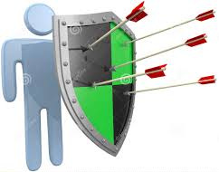
What is Security?
Security – Why???
Resource
Threat
Protection
Information Sharing
Notes:
9
I can't seem to find how to change the line spacing....

Slide 10

What is Security?
Possibly the most Secure
But is it usable??
Notes:
10
I can't seem to find how to change the line spacing....

Slide 11
What is Security?
“The quality or state of being secure—to be free from danger”
A successful organization should have multiple layers of security in place:
  Physical security
  Personal security
  Operations security
  Communications security
  Network security
  Information security

Slide 12
Why do we care?
Out-of-the-box Linux PC hooked to Internet, not announced:
  [30 seconds] First service probes/scans detected
  [1 hour] First compromise attempts detected
  [12 hours] PC fully compromised:
    Administrative access obtained
    Event logging selectively disabled
    System software modified to suit intruder
    Attack software installed
    PC actively probing for new hosts to intrude
Example sites that report incidents
  Computer Emergency Response Team (CERT)
  The Cyber Security Hub
Source –CERT Report

Slide 13
Recent security incidents
Twitter Data Breach
  affected 5.4 million accounts, including phone numbers and email addresses.
  data was collected in December 2021 using a Twitter API vulnerability disclosed in a bug bounty program that allowed people to submit phone numbers and email addresses into the API to retrieve the associated Twitter ID.
  using this ID, the threat actors could then retrieve public information about the account to create a user record containing both private and public information.
Uber Data Breach
  data breach occurred in 2016
  was revealed in 2017
  Uber admitted it covered up a data breach that affected 57 million users. The rideshare company paid $100,000 to the threat actors to ensure the information wasn’t made public.
Security Magazine, 2022

Slide 14
Recent security incidents
Student loan data breach
  confidential information of more than 2.5 million users to be leaked in June 2022, due to a vulnerability in its system
  student loan account registration information including names, home and email addresses, phone numbers and social security numbers, were accessible to an unknown third party from June until July 22, 2022.
More than 1.2 million credit card numbers leaked on hacking forum
  On October 12, 2022, carding marketplace BidenCash released the details of 1.2 million credit cards for free. The information containing credit cards expiring between 2023 and 2026, in addition to other details needed to make online transactions.
  BidenCash had previously leaked the details of thousands of credit cards in June 2022 as a way to promote the site. As the carding marketplace had been forced to launch new URLs three months later in September after suffering a series of DDoS attacks, some cyber security experts suggested this new release of details could be another attempt at advertising.
https://www.cshub.com/attacks/articles/the-biggest-data-breaches-and-leaks-of-2022

Slide 15
Recent security incidents
Personal and medical data for 11 million people accessed in Optus data breach
  Australian telecommunication company Optus suffered a devastating data breach on September 22, 2022 that has led to the details of 11 million customers being accessed.
  The information accessed included customers’ names, dates of birth, phone numbers, email and home addresses, driver’s license and/or passport numbers and Medicare ID numbers.
  Files containing this confidential information were posted on a hacking forum after Optus refused to pay a ransom demanded by the hacker. Victims of the breach also said that they were contacted by the supposed hacker demanding they pay AU$2,000 (US$1,300) or their data would be sold to other malicious parties.
https://www.cshub.com/attacks/articles/the-biggest-data-breaches-and-leaks-of-2022

Slide 16
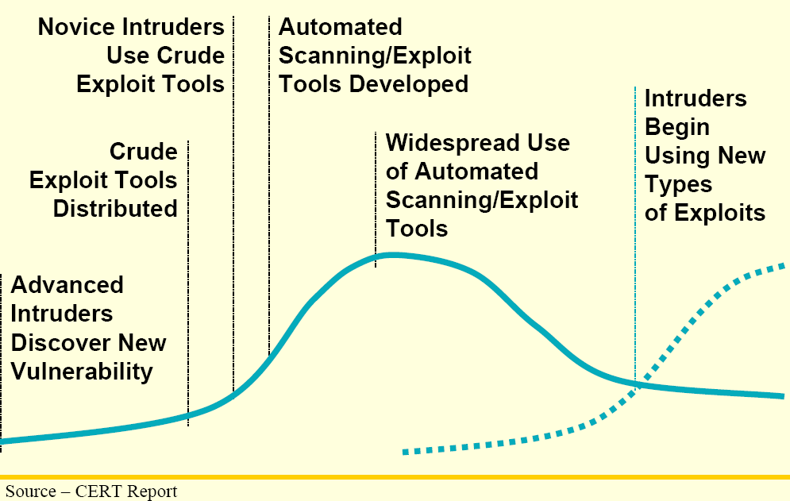
The situation we have today

Slide 17
So why are we so vulnerable?
Poor Software and Systems Design
  Buffer Overflow is the cause of almost half the known vulnerabilities
  Shrinking time to market leads to improperly tested software
  Security not considered during design time but only added later on
Lack of Education
  Secure programming techniques not taught in typical curriculum
  Lack of awareness about security issues
No Security Policies/Procedures in place
  Even when present, not followed
Lack of Deterrence Mechanisms
  Most criminal acts go unpunished

Slide 18
Many weak links
many weak links
  vulnerabilities in client software, server software, back-end databases
  web clients and servers
  the whole system is as secure as its weakest link
SERVER
CLIENT
Database
Database

Slide 19
Many Weak Links (continued)
Users
Fraudulent identification
Terminals
Terminals
Intercept
Tap
Crosstalk
Application Programs
Malicious code
Malicious code
DBMS
Computer Hardware
and Software
Unauthorized access
Malicious code
Failure of protection mechanisms
Database

Slide 20
Contributing Factors
Lack of awareness of Internet threats and risks
  Security measures are often not considered until an Enterprise has been penetrated by malicious users
Wide-open network policies
  Many Internet sites allow wide-open Internet access
Vast majority of Internet traffic is unencrypted
  Network traffic can be monitored and captured
Security is still too often an afterthought
  rather than being an integral part of the design process
The inherent nature of the Internet
  Targeted towards flexibility, interoperability, connectivity rather than security
  Lack of security in TCP/IP protocol suite
    Most TCP/IP protocols not built with security in mind
  New generation of protocols address this to a certain extent (Internet Engineering Task Force (IETF))

Slide 21
Contributing Factors
Complexity of security management and administration
In developing a particular security mechanism or algorithm, one must always consider potential attacks on those security features
Procedures used to provide particular services are often counterintuitive
Exploitation of software (e.g., protocol implementation) bugs
Cracker skills keep improving
Easy to commit crime due to
  lack of forensic evidence
  anonymity
  sensitive data repositories are vulnerable targets
  rare regular auditing of computer usage
  non-existing regulatory policies and laws
Cookies and privacy concerns
Executable contents (Java applets, activeX controls)
Push technology
CGI scripts

Slide 22
Contributing Factors
Security algorithms require that some secret information (e.g., keys) require creation, distribution, and protection of that secret information
Attackers only need to find a single weakness, while the designer must find and eliminate all weaknesses
Security requires regular and constant monitoring
Perceived as no return on investment by many
  Most organizations are reactive than proactive
Often need to sacrifice efficiency/user-friendliness

Slide 24
Basic Terminology
Confidentiality
  Concealment of information or resources
  Need arises in sensitive fields such as government and military
Integrity
  Trustworthiness of data or resources
  Phrased in terms of preventing improper or unauthorized change
  Data integrity and origin integrity
Availability
  Ability to use the information or resource desired
  An important aspect of reliability as well as of system design
  An unavailable system is at least as bad as no system at all

Slide 25
Key Security Objectives
concerned with
unauthorized
modification of
information
Integrity
Confidentiality
concerned with
unauthorized
disclosure of
information
Availability
concerned with
improper denial of
access to
information

Slide 26
Vulnerabilities, Threats and Attacks
Categories of vulnerabilities
    Corrupted (loss of integrity)
    Leaky (loss of confidentiality)
    Unavailable or very slow (loss of availability)
  Threats
    Capable of exploiting vulnerabilities
    Represent potential security harm to an asset
  Attacks (threats carried out)
    Passive – attempt to learn or make use of information from the system that does not affect system resources
    Active – attempt to alter system resources or affect their operation
    Insider – initiated by an entity inside the security perimeter
    Outsider – initiated from outside the perimeter

Slide 27
Threats and Attacks
Threat
  An event that may result in serious damage or harm a computer system
  If the threat actually materializes, it is an attack
Confidentiality, Integrity, Availability attempt to counter threats
Classification of Threats
  Disclosure – revelation of information or data
    Deception – sending false data
    Disruption – interfering with the correct operation
    Usurpation – completely overtake a system without authorization
Social Engineering Attacks

Slide 28
Countermeasures
Means used to deal with security attacks
Prevent
Detect
Recover
May itself introduce new vulnerabilities
Residual vulnerabilities may remain
Goal is to minimize residual level of risk to the assets

Slide 29
Passive and Active Attacks
Passive Attack
Active Attack
Attempts to learn or make use of information from the system but does not affect system resources
Eavesdropping on, or monitoring of, transmissions
Goal of attacker is to obtain information that is being transmitted
Two types:
  Release of message contents
  Traffic analysis
Attempts to alter system resources or affect their operation
Involve some modification of the data stream or the creation of a false stream
Four categories:
  Replay
  Masquerade
  Modification of messages
  Denial of service

Slide 30
Security Attacks
Any action that compromises the security of information.
Four types of attack:
    Interruption
    Interception
    Modification
    Fabrication
Basic model:
S
D
Source
Destination
30

Slide 31
Security Attacks (contd.)
Interruption:
  Attack on availability
Interception:
  Attack on confidentiality
S
D
S
D
I
31

Slide 32
Security Attacks
Modification:
  Attack on integrity
Fabrication:
  Attack on authenticity
D
S
I
D
S
I
32

Slide 33
Security Techniques
1) Prevention
  Prevent attackers from violating security policy
  Involves implementing mechanisms that users cannot override and are trusted to be implemented in correct and unalterable ways.
  E.g., access control
2) Detection
  Detect attackers’ violation of security policy
    Goal is to determine that an attack is underway, or has occurred and report it.
  auditing/intrusion detection
  incident handling
  Sometime detection is the only option, e.g.,
    Accountability in proper use of authorized privileges
    Modification of messages in a network

Slide 34
Security Techniques (continued)
3) Recovery
  Stop attack, assess and repair damage
  Continue to function correctly even if attack succeeds
  i.e., Resuming correct operation either after an attack or even while an attack is underway.
4) Tolerance
  practicality

Slide 35
Security Techniques (continued)
Security by Obscurity
  Security by obscurity says that if we hide the inner workings of a system it will be secure
  It is a bad idea
  Less and less applicable in the emerging world of vendor-independent open standards
  Less and less applicable in a world of widespread computer knowledge and expertise

Slide 36
Security Techniques (continued)
Security by legislation
  Security by legislation says that if we instruct our users on how to behave we can secure our systems
  It is a bad idea
  For example
    Users should not share passwords
    Users should not write down passwords
    Users should not type in their password when someone is looking over their shoulder
    Users should not open attachments from unknown parties
  User awareness and cooperation is important, but cannot be the principal focus for achieving security

Slide 37
Understanding Security
Authentication - Proving you are who you claim to be you are
  What you know – Password
  What you have – Access card
  Who you are – Fingerprint, Iris scan
Authorization
  What can you access
Accounting
  What you have accessed
Security Policy
    Statement of what is, and what is not, allowed
Security Mechanism
    Procedure to enforce security policy

Slide 38
Policies and Mechanisms
Policy says what is, and is not, allowed
  This defines “security” for the site/system/etc.
Mechanisms enforce policies
Composition of policies
  If policies conflict, discrepancies may create security vulnerabilities
38

Slide 39
Trust and Assumptions
Underlie all aspects of security
Policies
  Unambiguously partition system states
  Correctly capture security requirements
Mechanisms
  Assumed to enforce policy
  Support mechanisms work correctly
39

Slide 40
Types of Mechanisms
secure
precise
broad
set of reachable states
set of secure states
40

Slide 41
Assurance
Specification
  Requirements analysis
  Statement of desired functionality
Design
  How system will meet specification
Implementation
  Programs/systems that carry out design
41

Slide 42
Operational Issues
Cost-Benefit Analysis
  Is it cheaper to prevent or recover?
Risk Analysis
  Should we protect something?
  How much should we protect this thing?
Laws and Customs
  Are desired security measures illegal?
  Will people do them?
42

Slide 43
Human Issues
Organizational Problems
  Power and responsibility
  Financial benefits
People problems
  Outsiders and insiders
  Social engineering
43

Slide 44
Tying Together
Threats
Policy
Specification
Design
Implementation
Operation
44

Slide 45
Balancing Information Security and Access
Impossible to obtain perfect security
  It is a process NOT a turn-key product
  absolute security does not exist
  security in most systems can be improved
Security should be considered balance between protection and availability
To achieve balance, level of security must allow reasonable access, yet protect against threats

Slide 46
Security Trade-offs
confidentiality
integrity
availability
versus
cost
functionality
ease of use

Slide 47
Fundamental Security Design Principles that are Usable
Economy of mechanism
Fail-safe defaults
Complete mediation
Open design
Separation of privilege
Least privilege
Least common mechanism
Psychological acceptability
Isolation
Encapsulation
Modularity
Layering
Least astonishment

Slide 48
Thank You

