Slide 1
CS61065: Theory and Applications of Blockchain
BLOCKCHAIN ELEMENTS
Shamik Sural
shamik@cse.iitkgp.ac.in

Slide 2
What is Blockchain?
A Platform for executing transactional services
Spanned over multiple organizations or individuals who may not (need not) trust each other
An append-only shared ledger of digitally signed and encrypted transactions replicated across a network of peer nodes

Slide 3
The Block in a Blockchain – Securing Data Cryptographically
Digitally signed and encrypted transactions “verified” by peers
Cryptographic security – Ensures that participants can only view information on the ledger that they are authorized to see
Image source: http://dataconomy.com/

Slide 4
Structure of a Block
A block is a container data structure that contains a series of transactions
In Bitcoin: A block may contain more than 500 transactions on average, the average size of a block is around 1 MB (an upper bound proposed by Satoshi Nakamoto in 2010)
  May grow up to 8 MB or sometime higher (several conflicting views on this!!)
  Larger blocks can help in processing large number of transactions in one go.
  But longer time for verification and propagation

Slide 5
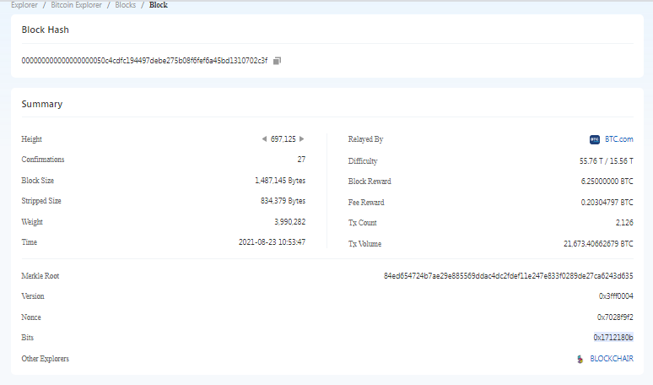
Structure of a Block (Reference: Bitcoin)
Two components:
  Block Header
  List of Transactions
Block Source: https://btc.com/btc/blocks OR https://blockchain.com/explorer

Slide 6
Block Header (Reference: Bitcoin)
Metadata about a block – (1) Previous block hash, (2) Mining statistics used to construct the block, (3) Merkle tree root
Previous block hash: Every block inherits from the previous block – we use previous block’s hash to create the new block’s hash – make the blockchain tamper proof.
H0
H1 = Hash(H0)
H2 = Hash(H1)
H3 = Hash(H2)
H4 = Hash(H3)

Slide 7
Block Generation Puzzle
Block Header
Block Header
Block Header
Previous Hash
Nonce
Previous Hash
Nonce
Previous Hash
Nonce
Merkle Root
Block Hash
Merkle Root
Block Hash
Merkle Root
Block Hash
Find out the nonce which generates the desired hash (certain zero bits at the prefix - 0000000000000000004a2b84f93a285b7a7………)

Slide 8
Block Header (Reference: Bitcoin)
Mining – the mechanism to generate the hash
  The mechanism needs to be complicated enough, to make the blockchain tamper proof
  Bitcoin Mining: H_{k} = Hash(H_{k-1} || T || Nonce || Something more)
  Find the nonce such that H_{k} has certain predefined complexity (value less than a target value)
The header contains mining statistics – timestamp, nonce and difficulty
Understanding Difficulty and Bits https://medium.com/@dongha.sohn/bitcoin-6-target-and-difficulty-ee3bc9cc5962
Difficulty is the largest target (0x0000 0000 00FF FF00 0000 0000 0000 0000 0000 0000 0000 0000 0000 0000 0000 0000) divided by the current target, e.g., (0x0000 0000 0000 0000 0012 180B 0000 0000 0000 0000 0000 0000 0000 0000 0000 0000)
Remember: “Cost of Mining” – Pretty High (Computing Power and Energy)
H0
H1 = Hash(H0)
H2 = Hash(H1)
H3 = Hash(H2)
H4 = Hash(H3)

Slide 9
The Hashes in a Block Header (Reference: Bitcoin)
Block identifier – the hash of the current block header (Hash algorithm: Double SHA256)
Merkle Root
Previous block hash is used to compute the current block hash
Timestamp, Previous hash, Merkle root, Difficulty Bits, Nonce and Version used to compute current hash
DEMO
https://cse.buffalo.edu/blockchain/blockhash.html
Block Source: https://btc.com/btc/blocks

Slide 10
Block Generation Cost
Energy efficiency ~0.098 J/GH = ~100 J/TH
ASIC Hardware for bitcoin can perform about 750 TH/s
Hash rate of the Bitcoin network approx. 120M TH/s!! Many actually go waste ☹ https://www.blockchain.com/charts/hash-rate
Bitcoin network consumes about 80 TW-hours of electricity annually. These figures vary between sources and are all some form of estimates
Average household in Germany of four people consumes approx. 4,000 KW-hours of electricity per year.
Can power about 20,000 households
Concept of Pooling is used
What ensures tamperproof operation in terms of honest nodes??

Slide 11
The Blockchain Replicas
Every peer in a Blockchain network maintains a local copy of the Blockchain.
Size is just about 591 GB ☺
As a new user joins the network, she can get the whole copy
Requirements
  All the replicas need to be updated with the last mined block
  All the replicas need to be consistent – the copies of the Blockchain at different peers need to be exactly similar

Slide 12
Transactions in a Block (Reference: Bitcoin)
Transactions are organized as a Merkle Tree. The Merkle Root is used to construct the block hash
If you change a transaction, you need to change all the subsequent block hashes
The difficulty of the mining algorithm determines the toughness of tampering with a block in a blockchain

Slide 13
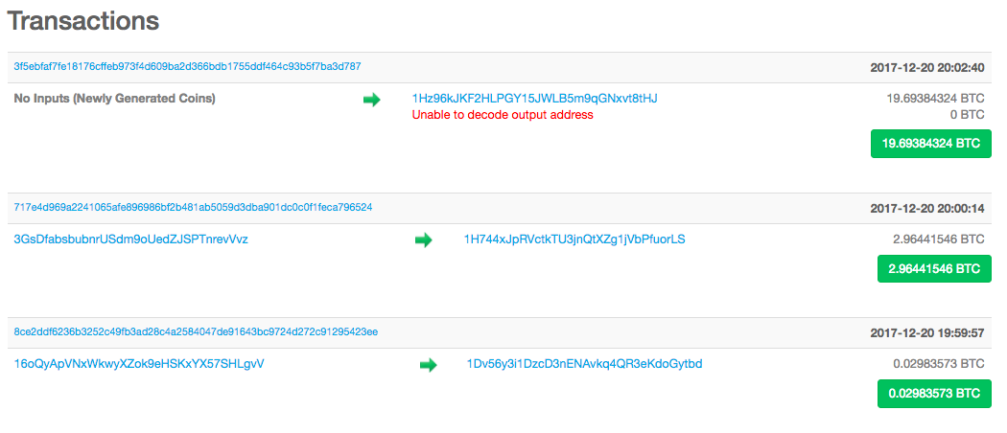
Transactions in a Block (Reference: Bitcoin)
Block Source: https://blockchain.info/

Slide 14
Bitcoin Transactions and Input and Output
TX 1
TX 3
TX 0
input()
10 BTC
input()
input()
100 BTC
40 BTC
output1()
30 BTC
output1()
10 BTC
output1()
output2()
output2()
TX 2
TX 4
60 BTC
input()
input()
50 BTC
output1()
output1()

Slide 15
Bitcoin Scripts – A Simple Example
T_{(A->B)}
How Bob will verify that the transaction is actually originated from Alice?

Slide 16
Bitcoin Scripts – A Simple Example
T_{(A->B)}
K^{A}_{PUB}, S_{A}(T_{(A->B)})
Send the public key of Alice along with the signature -> Bob can verify this

Slide 17
Bitcoin Scripts – A Simple Example
T_{(A->B)}
K^{A}_{PUB}, S_{A}(T_{(A->B)})
Bitcoin indeed transfers scripts instead of the signature and the public key

Slide 18
Bitcoin Scripts – A Simple Example
T_{(A->B)}
scriptPubKey, scriptSig
Bitcoin indeed transfers scripts instead of the signature and the public key

Slide 19
Bitcoin Scripts – A Simple Example
T_{(A->B)}
scriptPubKey, scriptSig
Bob can spend the bitcoins only if both the scripts return true after execution

Slide 20
Bitcoin Scripts
Simple, compact, stack-based and processed left to right
  FORTH like language
Not Turing Complete (no loops)
  Halting problem is not there

Slide 21
Bitcoin Scripts
With every transaction Bob must provide
  A public key that, when hashed, yields the address of Bob embedded in the script
  A signature to provide ownership of the private key corresponding to the public key of Bob

Slide 22
Bitcoin Scripts
18E14A7B6A30…
D61967F63C7DD…
Transaction Input
scriptSig:
OP_DUP
OP_HASH160
16UwLL9Risc3QfPqBUvKof…
OP_EQUALVERIFY
OP_CHECKSIG
Transaction Output
scriptPubKey:
See for detailed steps: https://developer.bitcoin.org/devguide/transactions.html
Simple Example: https://medium.com/@aalim.khan/bitcoin-transactions-scripts-and-digital-signatures-506688e1630a

Slide 23
Bitcoin Scripts
scriptPubKey: OP_DUP OP_HASH160 <pubKeyHash> OP_EQUALVERIFY OP_CHECKSIG
scriptSig: <sig> <pubKey>
The stack is initially empty. Both the scripts are combined – input followed by output
<sig> <pubKey> OP_DUP OP_HASH160 <pubKeyHash> OP_EQUALVERIFY OP_CHECKSIG

Slide 24
Bitcoin Scripts
<sig> <pubKey> OP_DUP OP_HASH160 <pubKeyHash> OP_EQUALVERIFY OP_CHECKSIG
<pubKey>
<sig>
The stack is initially empty. Both the scripts are combined
OP_DUP OP_HASH160 <pubKeyHash> OP_EQUALVERIFY OP_CHECKSIG

Slide 25
Bitcoin Scripts
OP_DUP OP_HASH160 <pubKeyHash> OP_EQUALVERIFY OP_CHECKSIG
<pubKey>
<pubKey>
<sig>
Top stack item is duplicated
OP_HASH160 <pubKeyHash> OP_EQUALVERIFY OP_CHECKSIG

Slide 26
Bitcoin Scripts
<pubHash>
OP_HASH160 <pubKeyHash> OP_EQUALVERIFY OP_CHECKSIG
<pubKey>
<sig>
Top stack item is hashed (RIPEMD-160 hashing)
<pubKeyHash> OP_EQUALVERIFY OP_CHECKSIG

Slide 27
Bitcoin Scripts
<pubKeyHash>
<pubKeyHash> OP_EQUALVERIFY OP_CHECKSIG
<pubHash>
<pubKey>
The constant is pushed in the stack
<sig>
OP_EQUALVERIFY OP_CHECKSIG

Slide 28
Bitcoin Scripts
<pubKeyHash>
OP_EQUALVERIFY OP_CHECKSIG
<pubHash>
<pubKey>
Equality is checked between the top two items in the stack
<sig>
OP_CHECKSIG

Slide 29
Bitcoin Scripts
<pubKey>
OP_CHECKSIG
<sig>
Signature is checked based on the top two stack item
TRUE

Slide 30
Bitcoin Script Instructions
Total 256 opcodes (15 disabled, 75 reserved)
  Arithmetic operations
  if-then conditions
  Logical operators
  Data handling (like OP_DUP)
  Cryptographic operations
    Hash functions
    Signature verification
    Multi-signature verification

Slide 31
Interesting Bitcoin Scripts
Provably un-spendable or prunable outputs
scriptPubKey: OP_RETURN {zero or more ops}
Anyone-can-spend outputs
scriptPubKey: {empty}
scriptSig: OP_TRUE
Source: https://en.bitcoin.it/wiki/Script

Slide 32
Interesting Bitcoin Scripts
Freezing funds until a time in the future
scriptPubKey: <expiry_time> OP_CHECKLOCKTIMEVERIFY OP_DROP OP_DUP OP_HASH160 <pubKeyHash> OP_EQUALVERIFY OP_CHECKSIG
scriptSig: <sig> <pubKey>
Source: https://en.bitcoin.it/wiki/Script

Slide 33
Bitcoin P2P Network
An ad-hoc network with random topology, Bitcoin protocol runs on TCP port 8333
All nodes (users) in the bitcoin network are treated equally
New nodes can join any time, non-responding nodes are removed after 3 hours

Slide 34
Joining in a Bitcoin P2P Network

Slide 35
Joining in a Bitcoin P2P Network

Slide 36
Joining in a Bitcoin P2P Network
Seed Node
Give me the address

Slide 37
Joining in a Bitcoin P2P Network
Seed Node
<address list>

Slide 38
Joining in a Bitcoin P2P Network
Seed Node

Slide 39
Joining in a Bitcoin P2P Network
Get most recent blockchain

Slide 40
Joining in a Bitcoin P2P Network
Start transaction

Slide 41
Transaction in a Bitcoin Network
Alice joins the Bitcoin network by opening her applet
Alice makes a transaction to Bob: A->B: BTC 10
Alice includes the scripts with the transactions
Alice broadcasts this transaction in the Bitcoin network

Slide 42
Transaction Flooding in a Bitcoin Network

Slide 43
Transaction Flooding in a Bitcoin Network
A->B:BTC10
A->B:BTC10
A->B:BTC10

Slide 44
Transaction Flooding in a Bitcoin Network
Validate the Transaction
A->B:BTC10

Slide 45
Transaction Flooding in a Bitcoin Network
Flood the Transaction
A->B:BTC10
A->B:BTC10
A->B:BTC10
A->B:BTC10

Slide 46
Transaction Flooding in a Bitcoin Network
I have already seen the transaction
A->B:BTC10
A->B:BTC10
A->B:BTC10
A->B:BTC10

Slide 47
Which Transactions Should You Relay?
The transaction is valid with current blockchain
  No conflict
  No double spending
The script matches with a pre-given set of whitelist scripts – avoid unusual scripts, avoid infinite loops
Does not conflict with other transactions that I have relayed after getting the blockchain updated – avoid double spending

Slide 48
Transaction Flooding in a Bitcoin Network
A->B:BTC10
C->D:BTC20
A->B:BTC10
C->D:BTC20
A->B:BTC10
A->B:BTC10
A->B:BTC10
C->D:BTC20
C->D:BTC20
C->D:BTC20
A->B:BTC10
Different nodes may have different transaction pools
A->B:BTC10
Accept the first set of transactions that you have heard

Slide 49
Transaction Flooding in a Bitcoin Network
A->B:BTC10
C->D:BTC20
A->B:BTC10
C->D:BTC20
A->B:BTC10
A->B:BTC10
A->B:BTC10
C->D:BTC20
C->D:BTC20
C->D:BTC20
A->B:BTC10
Accept the first set of transactions that you have heard
A->B:BTC10

Slide 50
Mining in a Bitcoin Network
Miner collects all the transactions flooded and starts Mining

Slide 51
Block Generation
The miner who solves the
puzzle first, generates a new block

Slide 52
Block Flooding
Flood the blockchain with the
new block included

Slide 53
Block Propagation
Multiple miners can mine a
new block simultaneously or in a near identical time

Slide 54
Block Propagation – Accept the Longest Chain
Block 3
Block 6
Block 1
Block 2
Block 5
Block 7
Block 8
Block 10
Block 4
Block 9

Slide 55
Block Propagation – Accept One of the Longest Chains
Block 3
Block 6
Block 1
Block 2
Block 5
Block 7
Block 8
Block 10
Block 4
Block 9
Block 11
“Accidental” forks occur rarely. Even if they occur, eventually only one becomes part of the longest chain
There are “intentional” forks of two type: hard forks and soft forks to come up with new versions like Bitcoin Cash, etc., or to upgrade software versions
Will be further discussed during our lectures on consensus

Slide 56
Which Block to Relay
Block contains the correct hash based on the existing blockchain
All the transactions inside the block are valid
  Check the scripts
  Validate with the existing blockchain
The block is included in the current longest chain
  Do not relay the forks

Slide 57
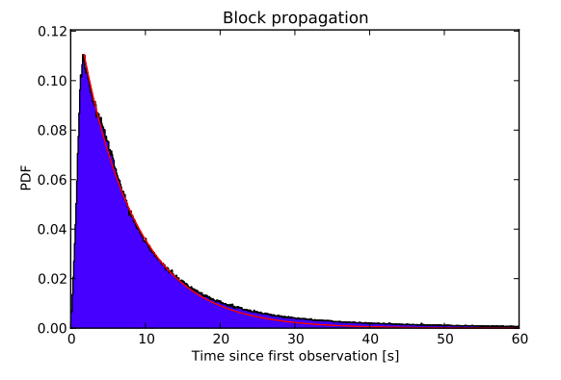
Block Propagation Latency
Mean time = 12.6 Seconds
95% of the nodes can see the block within 40 seconds
Decker, Christian, and Roger Wattenhofer. "Information propagation in the bitcoin network." 2013 IEEE Thirteenth International Conference on Peer-to-Peer Computing (P2P). IEEE, 2013.

Slide 58
Bitcoin – The Beginning
“A decentralized digital currency enables instant payments to anyone, anywhere in the world” – en.bitcoin.it
No central authority, uses peer-to-peer technology
Two broad operations
  Transaction Management – transfer of bitcoins from one user to another
  Money Issuance – regulate the monetary base

Slide 59
Bitcoin Basics – Creation of Coins
Controlled Supply: Must be limited for the currency to have value – any maliciously generated currency needs to be rejected by the network
Bitcoins are generated during the mining – each time a user discovers a new block
The rate of block creation is adjusted every 2016 blocks to aim for a constant two week adjustment period
The last bitcoin will be mined in 2140 (estimated and unless changed)

Slide 60
Bitcoin Basics – Creation of Coins
The number of bitcoins generated per block is set to decrease geometrically, with a 50% reduction for every 210,000 blocks, or approximately 4 years
This reduces, with time, the amount of bitcoins generated per block
  Theoretical limit for total bitcoins: Slightly less than 21 million
  Miners will get less reward as time progresses
  How to pay the mining fee – increase the transaction fee

Slide 61
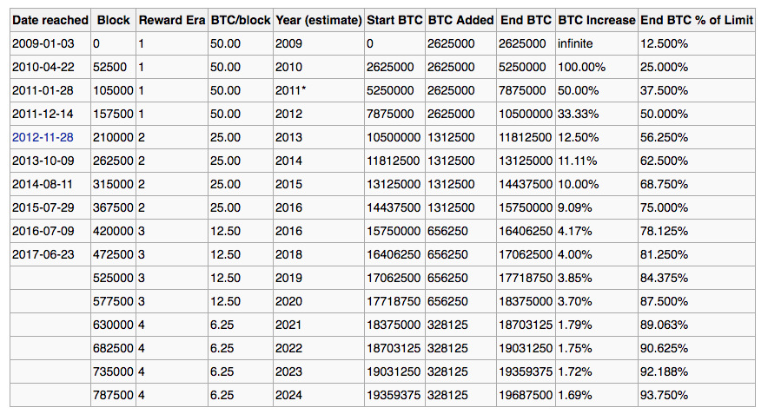
Projected Bitcoins
Information Source: https://en.bitcoin.it/wiki/

Slide 62
Bitcoin Basics – Sending Payments
Alice wants to send bitcoin to Bob
  Bob sends his address to Alice
  Alice adds Bob’s address and the amount of bitcoins to transfer in a “transaction” message
  Alice signs the transaction with her private key, and announces her public key for signature verification
  Alice broadcasts the transaction on the Bitcoin network for all to see

Slide 63
Handle Double Spending using Blockchain
When multiple valid continuation to this chain appear, only the longest such branch is accepted and it is then extended further (longest chain)
Once a transaction is committed in the blockchain, everyone in the network can validate all the transactions by using Alice’s public address
The validation prevents double spending in bitcoin

Slide 64
Bitcoin Anonymity
Bitcoin is permission-less, you do not need to setup any “account”, or required any e-mail address, user name or password to login to the wallet
The public and the private keys do not need to be registered, the wallet can generate them for the users
The bitcoin address is used for transaction, not the user name or identity
A bitcoin address mathematically corresponds to a public key based on ECDSA – the digital signature algorithm used in bitcoin
A sample bitcoin address: 1PHYrmdJ22MKbJevpb3MBNpVckjZHt89hz
Each person can have many such addresses, each with its own balance
  Difficult to know which person owns what amount

Slide 65
To Sum it All Up!!
Bitcoins do not really “exist” as any tangible or electronic object.
There is no bit”coin” as you see in its logo
Owning a bitcoin simply means you have access to a key pair that includes
  A public key to which somebody else had sent some bitcoin
  A matching private key that gives you the authority to send the previously received bitcoin to another address
If you lose your private key, you lose the corresponding bitcoin(s)

Slide 66
Physical Payment using Bitcoin
All that is needed is a (set of) private key(s) – Public key can be generated from the private key.
Safely store the private key – in your desktop, on the web, mobile phone, special hardware attachment, printed on a piece of paper as QR
For online payment, you can use the wallet and an appropriate mode of applying the private key
For off line payments like in store payments or paying to your friend, you can use your mobile phone to present the private key or use the hardcopy!! As simple as using PayTm, Google Pay and so on.

Slide 67
Bitcoin Exchange
Trading bitcoin as commodity
Centralized exchanges – (In India: WazirX, CoinDCX, Zebpay, CoinSwitch Kuber, etc.)
  Identity verification using KYC documents
  Maintain your balance in Bitcoin and another currency like INR.
  You set the buying and selling prices and quantities
  If necessary, you can take the money out in a preferred currency
  Some exchanges provide the payout option in anonymous prepaid cards
There can also be decentralized exchanges with appropriate procedures for handling similar requirements

