Slide 1
CS61065: Theory and Applications of Blockchain
BLOCKCHAIN INTEROPERABILITY
Department of Computer Science and Engineering
Shamik Sural
shamik@cse.iitkgp.ac.in

Slide 2
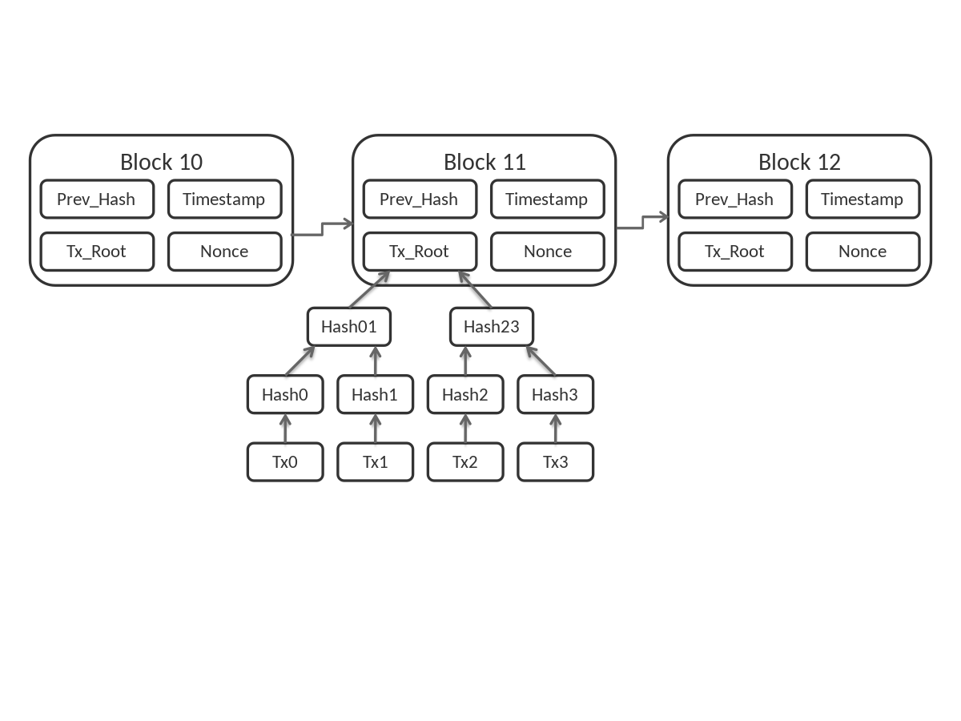
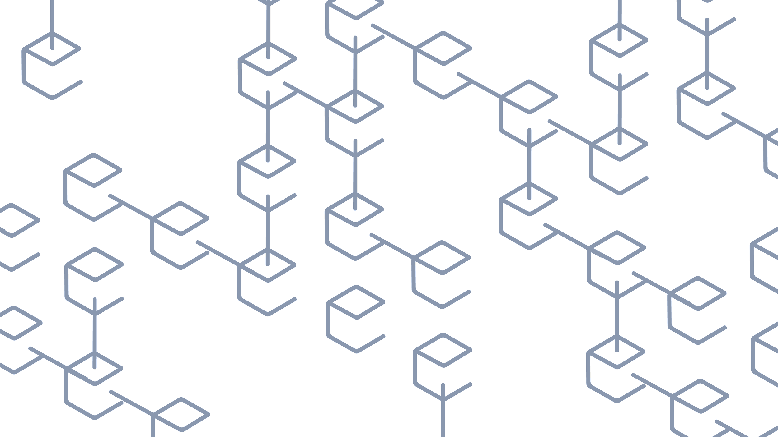
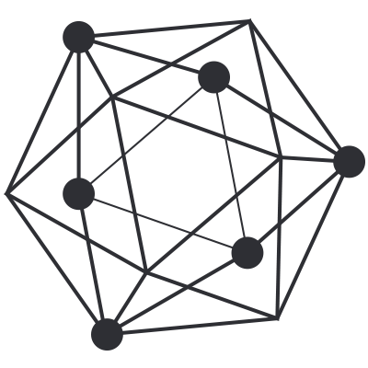
Blockchains
Public/Open
(Permissionless)
Private/Closed
(Permissioned)

Slide 3
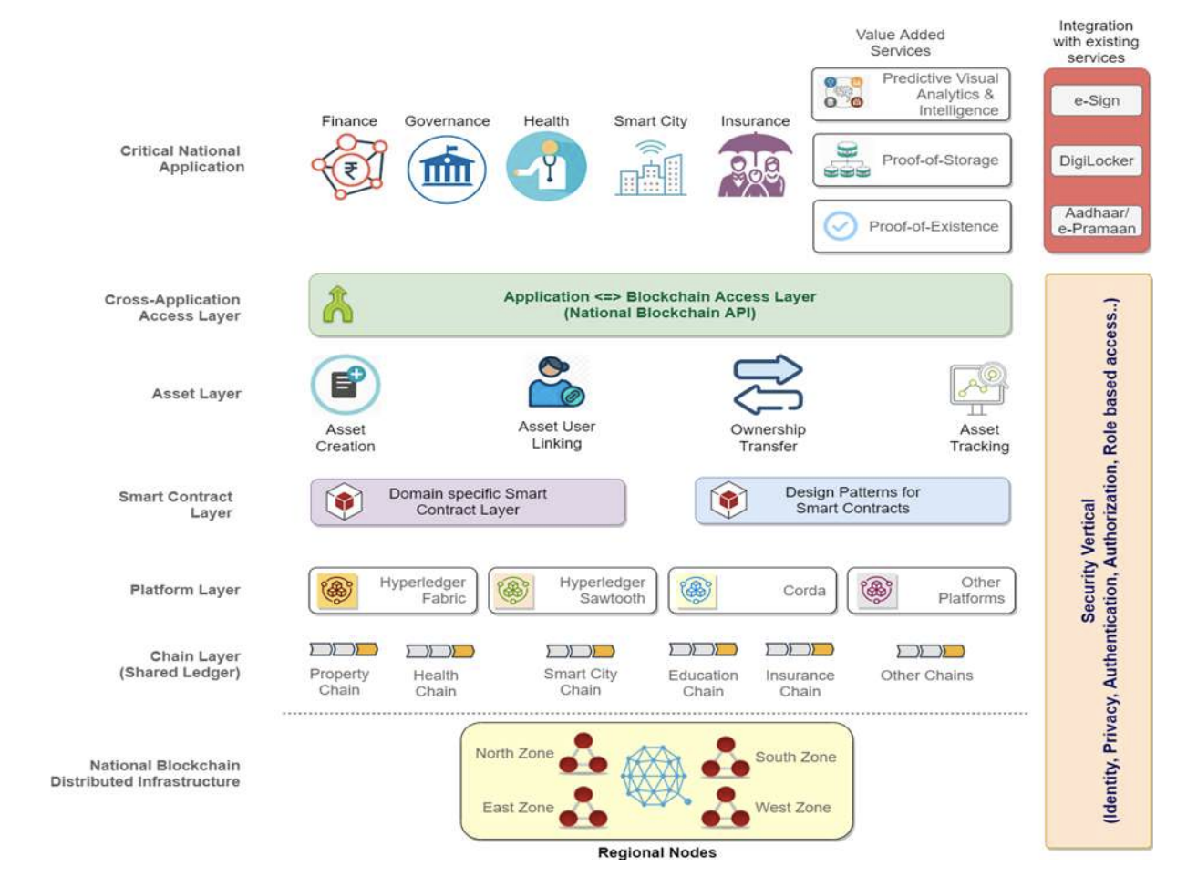


Slide 4

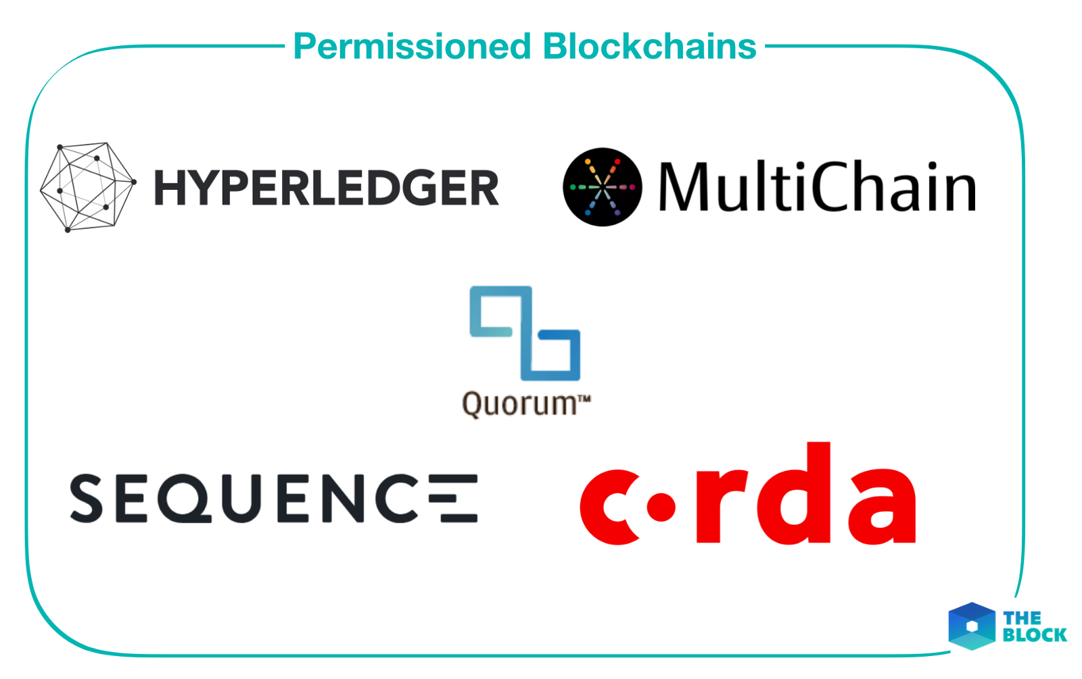
Public/Open
(Permissionless)
Private/Closed
(Permissioned)

Slide 5
Interoperability in Permissionless and Permissioned Blockchains
Permissionless Blockchain
  Asset Transfer
  Crypto currency driven
Permissioned Blockchain
  Data Transfer
  Consensus-driven

Slide 6
Permissionless Blockchain Interoperability

Slide 7
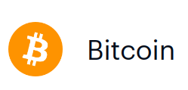











Public Blockchains as Isolated Silos
Blockchain-based cryptocurrencies enable secure and trustless currency transactions between parties.
There are currently over 2000 different cryptocurrencies in operation.
Separate blockchain networks with often different protocols and standards
Continue to operate in complete isolation from one another.
Bentov, Iddo, Yan Ji, Fan Zhang, Lorenz Breidenbach, Philip Daian, and Ari Juels. "Tesseract: Real-time cryptocurrency exchange using trusted hardware." In Proceedings of ACM SIGSAC Conference on Computer and Communications Security. 2019.

Slide 8

Cross Chain Asset Transfer
1 BTC
33 ETH
Alice
Alice
Bitcoin Network
Ethereum Network

Slide 9

Cross Chain Asset Transfer
Possible between different accounts and holders also.
1 BTC
33 ETH
Bob
Alice
Bitcoin Network
Ethereum Network

Slide 10
Cross Chain Asset Transfer
To do the transfer, Alice must use some third party who owns ≥ 33 ETH
1 BTC
33 ETH
Bob
Alice
Bitcoin Network
Ethereum Network

Slide 11

Cross Chain Asset Transfer - TTP
1 BTC
33 ETH
Trusted Third Party
Bob
Alice
Bitcoin Network
Ethereum Network

Slide 12
TTP based Asset Transfer
There are hundreds of centralized cryptocurrency exchanges now.
Centralized, users transfer ownership of their funds to the sole control of the exchange administrator.
Fast, once the deposit is done, the transfer to the destination network is often very fast (in milliseconds).
Lack of security: There has been numerous cases of theft from centralized exchanges.
650,000 bitcoins lost when the MtGox exchange shut down in 2014.
Users of the Bitfinex exchange lost approximately 120,000 bitcoins in 2016
https://bitcointalk.org/index.php?topic=576337
https://www.reuters.com/article/us-bitcoin-mtgox-wallet-idUSBREA2K05N20140321
https://www.reuters.com/article/us-bitfinex-hacked-hongkong-idUSKCN10E0KP

Slide 13
Asset Exchange
1 BTC
Bob
33 ETH
Alice
Alice
Bob
Bitcoin Network
Ethereum Network
1
2
Transfer in both the networks from Alice to Bob (1) and from Bob to Alice (2) must be ATOMIC.

Slide 14
Asset Exchange - Problems
Without the presence of any Escrow, the funds are in control of the sender and receiver parties.
One party might abort the exchange after receiving funds.
Synchronization problems between the two networks, as well as sender and receiver.
Difficulty in agreement on exchange rates which may keep on changing every second.

Slide 15

Cross Chain Asset Transfer using Atomic Exchange
1 BTC
33 ETH
33 ETH
Alice
(Sender)
Jack
(Exchanger)
Jack
(Exchanger)
Alice
(Sender)
Bob
(Receiver)
1
2
3
Bitcoin Network
Ethereum Network
Atomic Exchange Transfer
1
2
3
Therefore, solving atomic exchange will solve most challenges of asset transfer.

Slide 16
Atomic cross-chain swaps (PODC ‘18)
Atomicity: An atomic transaction is an indivisible series of operations, such that either all occur, or none occurs.
An atomic swap protocol guarantees:
(1) if all parties conform to the protocol, then all swaps take place
(2) if some parties deviate from the protocol, then no conforming party ends up worse off
(3) no coalition has an incentive to deviate from the protocol

Slide 17
Basic Idea
1 BTC
Alice
Bob
33 ETH
Initialize smart contracts on both ends with the amount.
Add a common spending condition, such that when the condition is met,
both the parties are paid simultaneously.
1 BTC
Alice
Contract A
(In Bitcoin Network)
Time
33 ETH
(In Ethereum Network)
Bob
Contract B
1 BTC
Some common event trigger
Contract A
Contract B
33 ETH
Bob
Alice
Atomic

Slide 18
Hashlock and Timelock
Hashlock: a function that restricts the spending of funds until a certain piece of data is publicly disclosed (as a cryptographic proof).
  Hash of a secret pre-image is posted as a hashlock.
  When the secret is revealed, the funds are released.
Timelock: is a function that restricts the spending of funds until a specific time (or block height) in the future.

Slide 19
Hash Locks
Hashlock is a type of encumbrance that restricts the spending of an output until a specified secret key is publicly revealed.
Inherent Property: Once any hashlock is opened publicly, any other hashlock secured using the same key can also be opened.
Example:
Alice generates a secret key “I love strawberries”
Alice computes the Cryptographic Hash of the key: f1b81571baac90bed544d1910f79ea5c31fa4509
Alice initiates a Hash Locked contract of 1 BTC (some amount) which has the conditions:
If key is revealed - pay BOB with 1 BTC.
The contract also contains the Hash, which allows any miner to verify the revealed key.

Slide 20
Time Locks
Timelock is a type of smart contract primitive that restricts the spending/transfer of some currency until a specified future time.
Block height may be used as a proxy for time.
Example:
Alice generates a timelocked contract with 1 BTC, and time = 2Δ ( Δ = some time unit )
Therefore, after 2Δ time, 1 BTC will be transferred to a target account.
( The target account can be Alice’s own account)

Slide 21
HTLC - Hash Time Locked Contract
Alice
1 BTC
Funding Contract - 1 BTC
Hash: ...Fa4509
Timeout: 2Δ
Key revealed
Timeout
OR
key: I love strawberries
+
Signature BOB
Time > 2Δ
1 BTC
1 BTC
Alice
Bob
Poon, Joseph, and Thaddeus Dryja. "The bitcoin lightning network: Scalable off-chain instant payments." (2016).

Slide 22
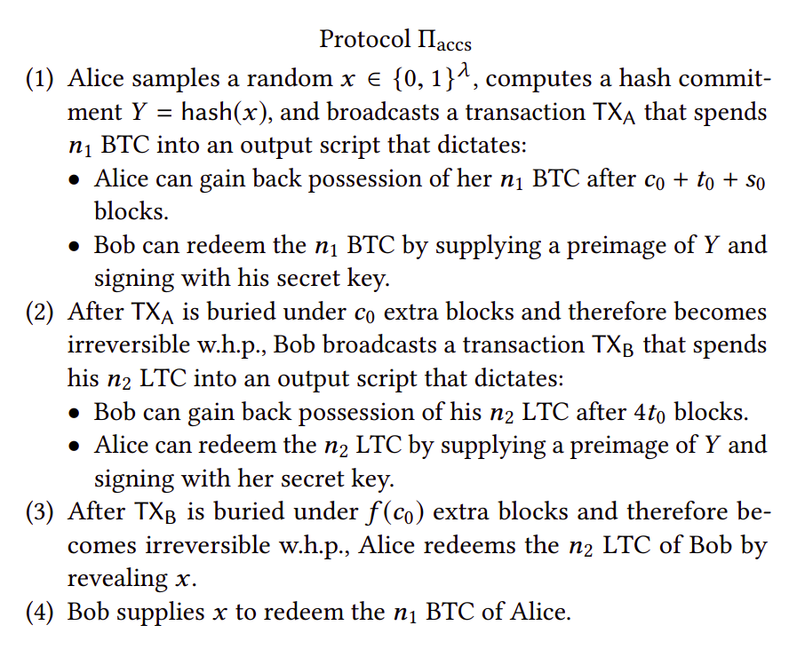
HTLC for Atomic Swap
For a nice illustrative example
Visit this site

Slide 23
HTLC for atomic swap
Generate Secret - key
Compute Hash H
Alice
H
33 ETH paid to Alice
Bob knows key now.
Bob
Verify Alice created the Funding HTLC with H
Verify Bob created the Funding HTLC with H
1 BTC paid to Bob
Redeem with key
Bitcoin Network
Alice: HTLC(1BTC, H, 4Δ)
Redeem with key
(thus key is revealed)
Ethereum Network
Bob: HTLC(33ETH, H, 2Δ)
Time

Slide 24
What if Alice does not reveal key ?
Generate Secret - key
Compute Hash H
Alice refuse to reveal key
Alice
H
1 BTC refunded to Alice
Bob
Verify Alice created the Funding HTLC with H
Verify Bob created the Funding HTLC with H
Alice: HTLC(1BTC, H, 4Δ)
TIMEOUT
Bitcoin Network
33 ETH refunded to Bob
Ethereum Network
Bob: HTLC(33ETH, H, 2Δ)
TIMEOUT
Time

Slide 25
Multi-Party Atomic Cross-chain Swap
Carol wants to sell her Cadillac for bitcoins. Alice is willing to buy Carol’s Cadillac, but she wants to pay in an “alt-coin” cryptocurrency
Bob is willing to trade alt-coins for bitcoins
Alice, Bob and Carol need to arrange a three-way swap:
    Alice will transfer her alt-coins to Bob
    Bob will transfer his bitcoins to Carol
    Carol will transfer title of her Cadillac to Alice
M. Herlihy, “Atomic cross-chain swaps,” in PODC, 2018.

Slide 26
Multi-Party Atomic Cross-chain Swap
Alice creates a secret s, h = H(s), and publishes a contract on the alt-coin blockchain with hashlock h and timelock 6Δ in the future, to transfer her alt-coins to Bob.
When Bob confirms that Alice’s contract has been published on the alt-coin blockchain, he publishes a contract on the Bitcoin blockchain with the same hashlock h but with timelock 5Δ in the future, to transfer his bitcoins to Carol.
When Carol confirms that Bob’s contract has been published on the Bitcoin blockchain, she publishes a contract on the automobile title blockchain with the same hashlock h, but with timeout 4Δ in the future, to transfer her Cadillac’s title to Alice.
When Alice confirms that Carol’s contract has been published on the title blockchain, she sends s to Carol’s contract, acquiring the title and revealing s to Carol.
Carol then sends s to Bob’s contract, acquiring the bitcoins and revealing s to Bob.
Bob sends s to Alice’s contract, acquiring the alt-coins and completing the swap.
M. Herlihy, “Atomic cross-chain swaps,” in PODC, 2018.

Slide 27
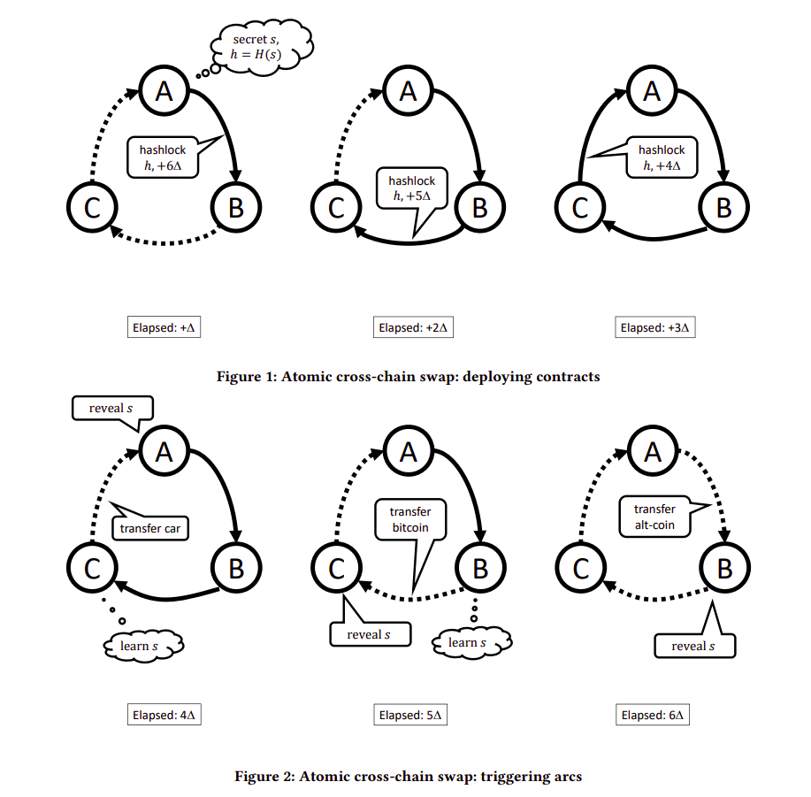
Multi-Party Atomic Cross-chain Swap
M. Herlihy, “Atomic cross-chain swaps,” in PODC, 2018.

Slide 28
Validity of the Protocool
If any party halts while contracts are being deployed, then all contracts eventually time out and trigger refunds.
If any party halts during triggering of contracts, only that party ends up worse off.
  If Carol halts without triggering her contract, then Alice gets the Cadillac and Bob gets a refund, so Carol’s misbehavior harms only herself.
The order in which contracts are deployed matters.
  If Carol were to post her contract with Alice before Bob posts his contract with Carol, then Alice could take ownership of the Cadillac without paying Carol.
Timelock values matter.
  If Carol’s contract with Bob were to expire at the same time as Bob’s contract with Alice, then Carol could reveal s to collect Bob’s bitcoins at the very last moment, leaving Bob no time to collect his alt-coins from Alice.
M. Herlihy, “Atomic cross-chain swaps,” in PODC, 2018.

Slide 29
Multi-Party Atomic Cross-chain Swap
What if parties behave irrationally?
  If Alice (irrationally) reveals s before the first phase completes, then Bob can take Alice’s altcoins and perhaps Carol can take Bob’s bitcoins, but Alice will not get her Cadillac, so only she is worse off.
Atomic swap protocol guarantees
  If all parties conform to the protocol, then all swaps take place
  If some parties deviate from the protocol, then no conforming party ends up worse off
  No coalition has an incentive to deviate from the protocol
M. Herlihy, “Atomic cross-chain swaps,” in PODC, 2018.

Slide 30
Limitations of this approach
Slow, often takes hours to execute.
Parties cannot respond to real time price fluctuations due to slow transactions.
Vulnerable to a weak denial-of-service attack where an adversarial party repeatedly proposes an attractive swap, and then fails to complete the protocol, triggering refunds, but temporarily rendering assets inaccessible.

Slide 31
Permissioned Blockchain Interoperability

Slide 32
Interoperation in Permissioned Blockchains
Permissioned blockchain networks are designed to be private, for a closed consortium.
Different business sectors tend to have different groups of organizations, thus have separate blockchain networks.
Eg: TradeLens - Logistics, We.Trade Trade finance, IBM Food Trust - Food Supply Chain, etc..
Continue to operate in complete isolation from one another.
Often there is need for interoperation between different isolated networks to achieve business goals.
Abebe, E., Behl, D., Govindarajan, C., Hu, Y., Karunamoorthy, D., Novotny, P., Pandit, V., Ramakrishna, V. and Vecchiola, C., 2019, December. Enabling enterprise blockchain interoperability with trusted data transfer (industry track). In Proceedings of the 20th International Middleware Conference Industrial Track

Slide 33
Interoperation in Permissioned Blockchains
Challenges
Here interoperation is specifically Verifiable Data Transfer between two separate permissioned blockchain networks.
Data in a blockchain network is generated by transactions going through consensus process.
Data has to be consistent with the source network’s state.
Multiparty Trust - When one network consumes state from another, it would need to establish the validity of the state according to the shared consensus view of parties in the network.

Slide 34






Use Case
9. Obtain Bill of Lading (Inter-Blockchain)
SELLER
7. Create Consignment
Simplified TradeLens
SELLER’S BANK
5. Request Booking
4. Approve L/C
10. Request Payment
6. Accept Booking
8. Upload Bill of Lading
Dispatch consignment
Simplified We.Trade
Purchase Order
(Off-Blockchain)
3. Propose L/C
CARRIER
BUYER
2. Request L/C
BUYER’S BANK
We.Trade is a trade financing network
TradeLens is trade logistics network
Letter of Credit (L/C) – a bank confirmation that ensures payment will be made by the buyer
Bill of lading proves that the seller has dispatched the goods via the carrier,
It enforces an obligation on the buyer (as per letter of credit terms) to make a payment.

Slide 35




Verifiable Data Transfer in Permissioned Blockchain
Enabling Enterprise Blockchain Interoperability with Trusted Data Transfer (Middleware ‘2019)
Each data (block) in a network has a set of endorsements (signatures) for consensus.
This set of endorsements confirm the validity of a block in the network.
Thus, from the source, data is accompanied with the set of signatures - Attestations.
The attestations are validated in the destination network according to an data acceptance policy.
BUYER’s BANK
SELLER
CARRIER
SELLER’s BANK
BUYER
SELLER
Network A
Network B

Slide 36
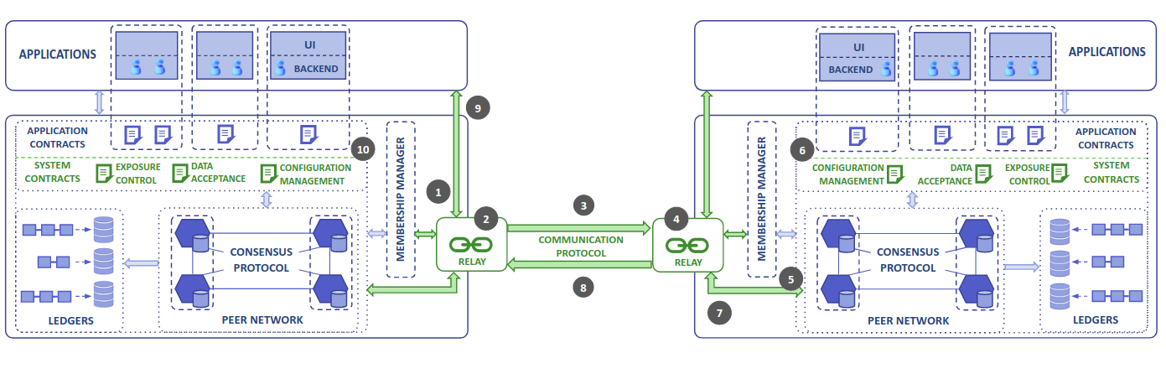
Architecture
Relay Service: Provides the means of communication between the two separate networks
Configuration Management Contract: Maintain identity (public keys) of the interoperating networks.
Exposure Control Contract: Define and enforce policies on what data to expose to which network.
Data Acceptance: Validate the data received from a foreign network against the policy that defines how many signatures are required (and other conditions) to verify a data.

Slide 37
Protocol Overview
Steps:
Proof request is generated consisting of a verification policy which has to be met by the source network.
Access control policies are checked.
Response data along with proofs (endorsements) is sent back through the relay.
The proofs are validated against the verification policy.
BUYER’s BANK
SELLER
CARRIER
SELLER’s BANK
BUYER
SELLER
Network A
Network B

Slide 38
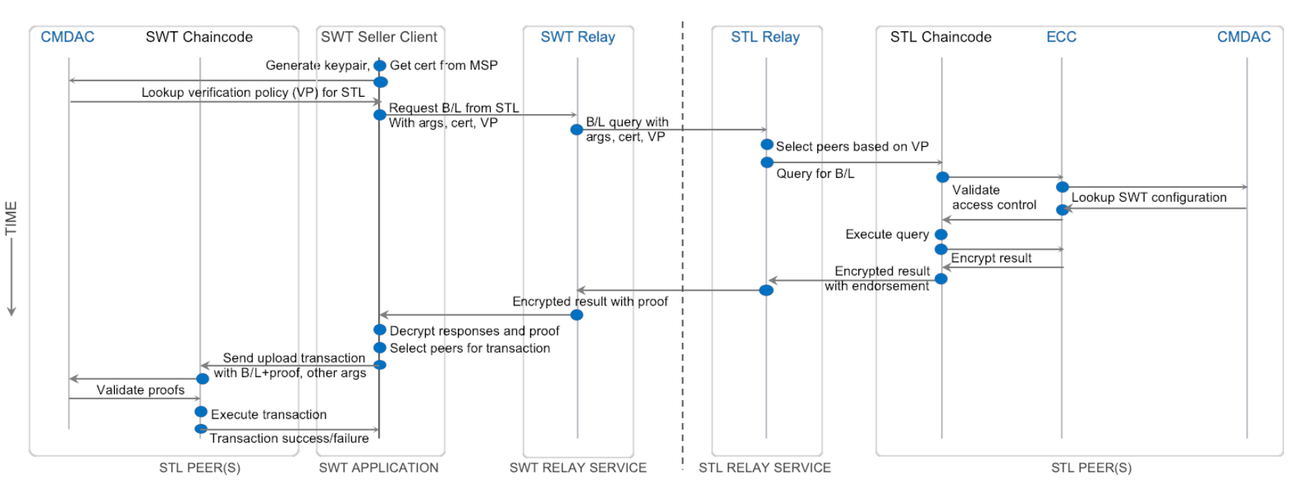
Protocol Overview

Slide 39
Tesseract (CCS ‘19)
Real time - as fast as centralized exchanges.
Can observe the buy (a.k.a. “bid”) and sell (a.k.a. “ask”) prices in real time and allow parties to modify their trading positions in milliseconds.
Supports cross chain asset exchanges.
Secure against theft by exchange operators.

Slide 40
Tesseract - Overview
Tesseract relies on a trusted execution environment (TEE)
TEE enables Tesseract to behave like a trusted third party, controlling funds without exposing them to theft while preventing frontrunning by the exchange operator.
Ensures all-or-nothing settlement
Rafael Pass, Elaine Shi, and Florian Tramer. Formal Abstractions for Attested Execution Secure Processors. In Eurocrypt 2017.

Slide 41
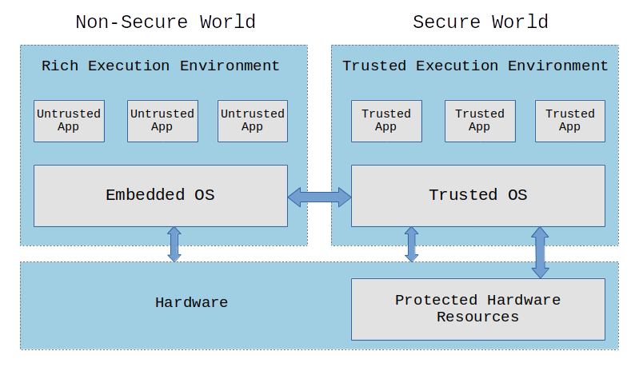
Trusted Execution Environment - TEE
TEE is a secure area of a main processor.
Guarantees code and data loaded inside to be protected with respect to:
  Isolated execution
  Integrity of applications
  Confidentiality of their assets
Provides attestation that an output represents the result of such an execution in the TEE.
https://embeddedbits.org/introduction-to-trusted-execution-environment-tee-arm-trustzone/

Slide 42
Tesseract - Threat Model
Assumes the security of TEE, and remote attestation.
  Code that runs inside the TEE enclave can neither be observed nor tampered with.
Strong network adversary that can gain complete OS and network control of the host in which the funds are stored.
Adversary’s goal is to maximize her profit.

Slide 43
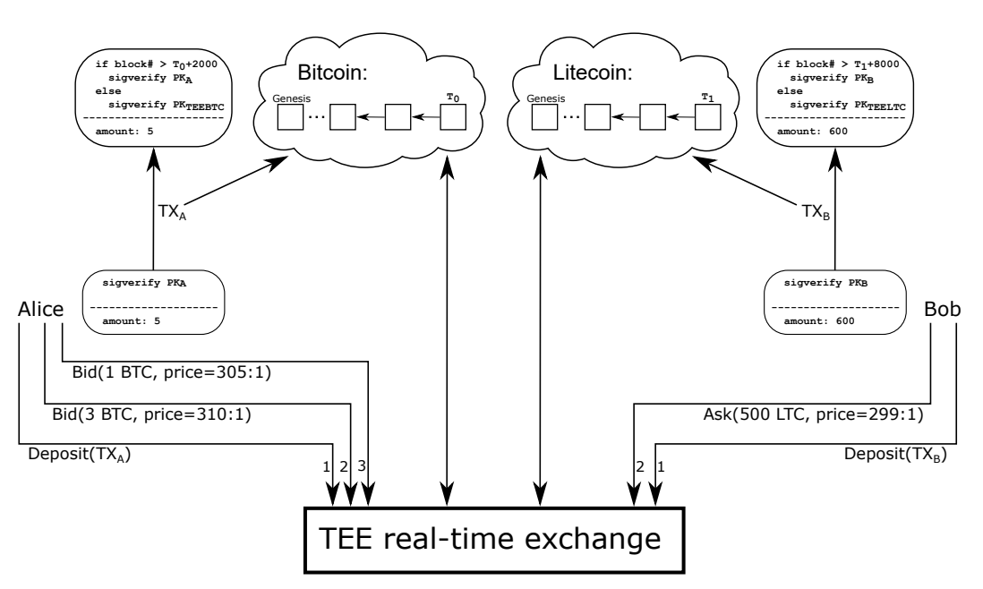
Tesseract - Design
Tesseract configured with Bitcoin and Litecoin networks.
The TEE forms the secure real-time exchange with which the parties interact to carry out asset swaps.

Slide 44
Tesseract - Steps
1
Initialization of exchange
Tesseract enclave is running light blockchain clients (SPV clients).
During initialization, the enclave fetches the latest blockchain state.
The enclave then invokes a key generation procedure to create a keypair (sk, pk) for each supported cryptocurrency.
The enclave will then attest pk as its deposit address, for each cryptocurrency.
The attested pk keys are published through multiple services - (such as websites, IPFS, and even Bitcoin and other blockchains).
The pk also forms the depositor address for Tesseract exchange in the corresponding cryptocurrency.
https://en.bitcoinwiki.org/wiki/Simplified_Payment_Verification

Slide 45
Tesseract - Steps
2
User Initialization
A new user opens a Tesseract account by depositing a significant amount into a deposit address of the exchange.
The proof of deposit is sent to the enclave in the form of the transaction, index of block, and Merkle tree.
Tesseract credits the user’s account (in the enclave) after verifying the deposit.
Tesseract also protects against replay attacks, by requiring strictly increasing block indices for the user’s deposits.
Each user account is identified by the user’s public key and hence the user can use its secret key to generate signed messages to interact with Tesseract.

Slide 46
Tesseract - Steps
3
Asset Exchange
Users post buy or sell orders along with their exchange rate. Orders are recorded in the enclave.
Eg: Bob bids to sell LTC for the price of 299 LTC per BTC
Alice bids to buy LTC price of 305 LTC per BTC.
Tesseract server publishes an anonymized version of the order book with remote attestation.
Realtime trading is executed by matching the buy and sell orders.
The trade results do not reflect in the blockchain networks immediately, and are only reflected in the tesseract exchange sandbox.
Periodically, settlement transactions are issued by tesseract in the blockchain networks to update users’ balance.
Tesseract exchange can be configured to collects a proportional fee for each successful trade (e.g 0.1% of amount). This will help in exchange owners to maintain their infrastructure.

Slide 47
Tesseract - Eclipse Attacks
Resistance against Eclipse Attacks is the most interesting aspect of Tesseract.
Tesseract enclave is preloaded with the current difficulty parameter of each PoW-based blockchain. This can be further verified by users before using the Tesseract exchange.
Assume adversary A controls < ½ of computational power.
A has total control over the network
Eclipse Attack:
A cuts the enclave off from the Bitcoin network and presents it with a fake blockchain containing a deposit transaction TX_{fake}
Tesseract monitors the rate at which blocks are being mined in the network. (e.g. ~10 minutes for bitcoin)
Fixed difficulty parameter -> A cannot change the difficulty, and forced to mine at the current difficulty.
A cannot mine at the required rate ( since A controls < ½ of computational power of main network).
TEE has a trusted clock. Attack is detected by Tesseract.

