Slide 1
CS61065: Theory and Applications of Blockchain
IDENTITY MANAGEMENT
Shamik Sural
shamik@cse.iitkgp.ac.in

Slide 2

What is Identity?
People are known by their identities - drives every business and social interactions
Physical Identity is a collection of attributes
  Name
  Age
  Financial history
  Work history
  Address history
  Social history
Source: https://securityintelligence.com/reimagining-the-future-of-identity-management-with-blockchain/

Slide 3




Centralized Digital Identity
Individuals do not have any control over the information that comprises their identities
Identity fraud - no visibility over the identity attributes
  Authentication
  Authorization
  Verification

Slide 4

Centralized Digital Identity
Individuals do not have any control over the information that comprises their identities
Identity fraud - no visibility over the identity attributes
  Authentication
  Authorization
  Verification

Slide 5
Digital Identity - Single Sign On (SSO)
Single identity for various purposes
  No need to maintain multiple identity documents
Widely conceptualized in software
industry
  One password to access multiple services
Single identity provider (IDP) maintains the identity
Identity consumers (services) use the IDP to authenticate
the identity holder
  During authentication, the identity is not exposed to the services
Image Source: https://www.e-spincorp.com/global-theme-and-feature-topics/single-sign-on-sso/

Slide 6
SSO and Decentralization
Public Sector
Services
Bank
Post Office
Authenticate User
Authenticate User
Identity Database
Mobile Companies for user identity verification
Recordkeeping Agency (IDP)
Validate
User

Slide 7
Decentralizing Digital Identity
No Centralized Trusted Identity Provider / Registry
Digital representation of physical identity.
Two major problems:
  Verifying the identity issuer
  Verifying the identity holder
Issuer - Government
Holder
Verifier

Slide 8
Decentralizing Digital Identity
No Centralized Trusted Identity Provider / Registry
Digital representation of physical identity.
Two major problems:
  Verifying the identity issuer
  Verifying the identity holder
Issuer - Government
Holder
Verifier

Slide 9
Fundamental Principles of Digital Identity Management
Self-Sovereign Identity (Privacy Control)
  Individual should have full control and ownership of their identity information
  Individuals can control the usage of their own identity profile for business and social interactions (Consent - agreement for information usage)
  Identical to how we use our physical identity
    Holder possesses the ID
    Holder chooses whom to present the ID
  Burden at individual user?

Slide 10
Decentralized Identifiers (DIDs)
Provides Verifiable, Decentralized Digital identity
Designed to be decoupled from:
  centralized registries
  identity providers
  certificate authorities
Holder of DID can prove its ownership on the DID without the help of any other party.
W3C Proposed Recommendation
https://www.w3.org/TR/did-core/

Slide 11
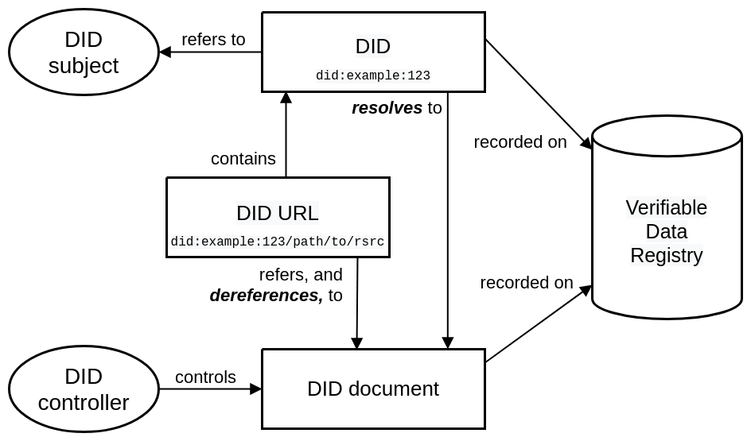
DID Architecture
https://www.w3.org/TR/did-core/

Slide 12
DID Architecture
1. Unique URI – identifies a subject.
2. Entity (person / organization / etc.. ) being identified.
5. System where DID documents are stored.
3. Entity with permission to change DID document. Might be same as subject.
4. Contains information (e.g public key of controller) about the DID.
https://www.w3.org/TR/did-core/

Slide 13
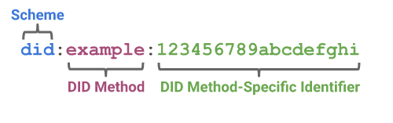
DID URI
Controller controls a DID Document.
A DID is a unique address (URI) to the location of that document.
System which supports DID scheme. - Eg. DID resolution.
Uniquely identifies a DID doc within the DID Method.
http://www.faqs.org/rfcs/rfc2396.html
https://www.w3.org/TR/did-core/

Slide 14
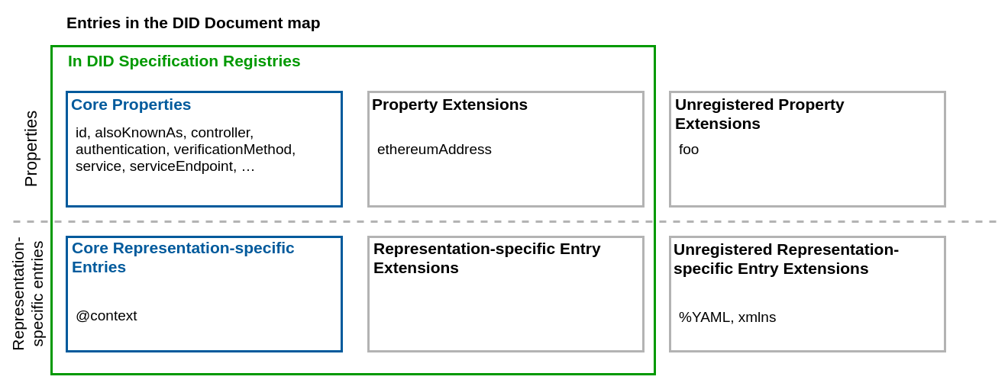
DID Document
A DID Document is a set of data describing the DID subject, including mechanisms, such as cryptographic public keys, that the DID subject or a DID delegate can use to authenticate itself and prove its association with the DID.
A DID document consists of a map of entries, where each entry consists of a key/value pair.
Extensions can also include
degree completed, etc.
Representation-specific entries include JSON, XML, etc
https://www.w3.org/TR/did-core/

Slide 15
DID Document Example (JSON)
{
  "id": "did:example:123456789abcdefghi",
  "authentication": [{
    "id": "did:example:123456789abcdefghi#keys-1",
    "type": "Ed25519VerificationKey2020",
    "controller": "did:example:123456789abcdefghi",
    "publicKeyMultibase": "zH3C2AVvLMv6gmMNam3uVAjZpfkcJCwDwnZn6z3wXmqPV"
  }],
  "service": [{
  "id":"did:example:123456789abcdefghi#linked-domain",
  "type": "LinkedDomains", // external (property value)
  "serviceEndpoint": https://bar.example.com
  }]
}
DID for a particular DID subject
Verification Method specifying how the DID subject can authenticate itself.
Service Endpoint denoting ways of communicating with the DID subject
It tells how to reach the subject. Otherwise, there is no meaningful use of authentication
Note: There is no sensitive information in DID document
https://www.w3.org/TR/did-core/

Slide 16
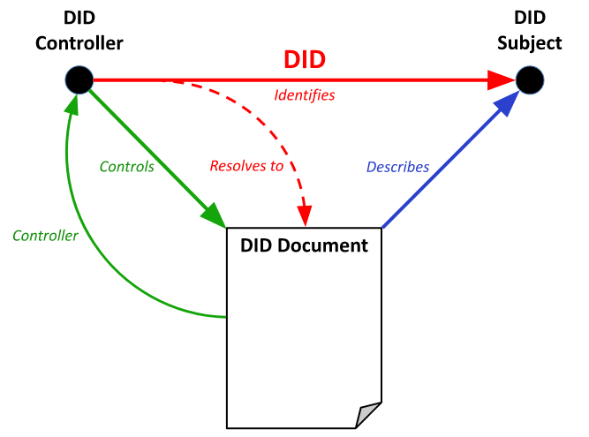
Relationship Between DID, DID Document and DID Controller
A DID is an identifier assigned by a DID controller to refer to a DID subject and resolve to a DID document that describes the DID subject.
- The DID document is an artifact of DID resolution and not a separate resource distinct from the DID subject.
DID document resides inside verifiable data registry

Slide 17
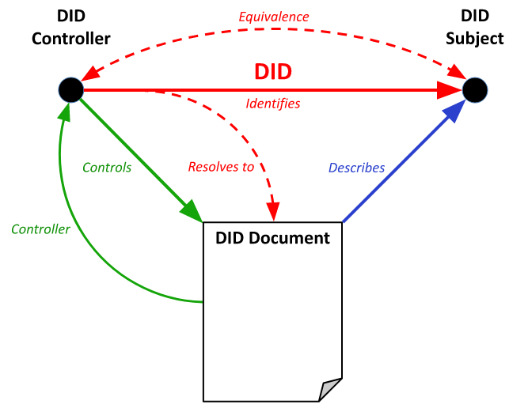
Relationship Between DID, DID Document and DID Controller
Often the DID Subject and the
DID Controller are the same entity.

Slide 18

DID Flow – DID Registration
Alice
1. Create DID Document
2. Register DID
3. Authenticates DID controller (here based on signature)
4. Updates DID Document
DID Doc
signedby(Sk)
id: did:registry1:alice,
authentication: Pk
controller: did:registry1:alice
0. Generate Keys
Public key: Pk,
Secret key: Sk
Verifiable Data Registry - (registry1)
DID Method Implementation

Slide 19

DID Flow – Proving Control over DID
Alice
1. Create DID Document
2. Register DID
3. Authenticates DID controller (here based on signature)
4. Updates DID Document
DID Doc
signedby(Sk)
id: did:registry1:alice,
authentication: Pk
controller: did:registry1:alice
0. Generate Keys
Public key: Pk,
Secret key: Sk
6. Authenticate Alice based on authentication method Pk
5. Fetch DID Document
for did:registry1:alice
Verifiable Data Registry - (registry1)
Bob
(wants to authenticate the subject of did:registry1:alice)
DID Method Implementation

Slide 20
DID Method Security
DID Registry ideally enforces DID Method protocols.
Centralized DID Registry brings in risks
  Manipulating DID Documents
    Changing authentication methods
  Censoring DID Documents
    Refusing to resolve certain DID Documents
Lack of Transparency.
Verifiable Data Registry - (registry1)
DID Method Implementation
Centralized

Slide 21
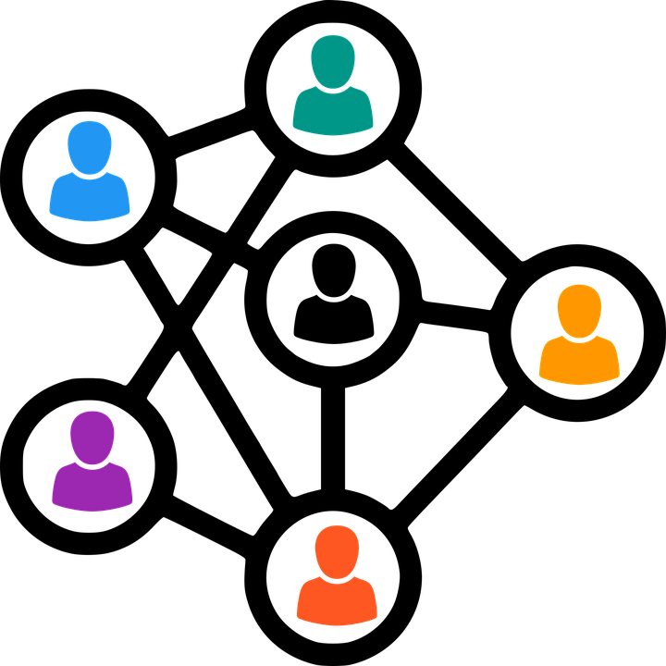
Decentralized DID Registry
Blockchain Based Implementation of Verifiable Data Registry
DID Methods are implemented as smart contracts.
  Smart contracts enforce how authorization is performed to execute all operations, including any necessary cryptographic processes.
Transparent Immutable Ledger allows verifiability of DID Documents
  Any party can validate if a DID Document's creation / updation transactions were authenticated or not.
Verifiable Data Registry

Slide 22


Blockchain based DID Registry
Public permissioned ledger based registry.
Any party can read the ledger.
Only selected (registered) parties and write to the ledger.
https://hyperledger-indy.readthedocs.io/en/latest/
Protocol for creating scalable DIDnetworks that can run atop any existing permissionless blockchain. (e.g. Bitcoin, Ethereum, etc.)
Sidetree
https://identity.foundation/sidetree/spec/

Slide 23
Binding DID to Physical Identity
DIDs only allow a DID controller to prove its control over its DID Document.
  This is useful to authenticate an entity with respect to its DID
Authenticate based on Pk
Fetch DID Doc
Public key: Pk,
Secret key: Sk
DID Doc - PK
Does not reveal any physical detail.
If some physical detail is presented, then that is only self attested by the DID controller, and not any verified information.

Slide 24
Binding DID to Physical Identity
DIDs only allow a DID controller to prove its control over its DID Document.
  This is useful to authenticate an entity with respect to its DID
Authenticate based on Pk
Fetch DID Doc
Public key: Pk,
Secret key: Sk
DID Doc - PK
Does not reveal any physical detail.
DID are not inherently tied to any physical identity (real world identity).

Slide 25
Verifiable Credentials
Verifiable Credentials Data Model – W3C Recommendation
Digital Representation of Credentials
  Driver's licenses - assert that capability of operating a motor vehicle
  University degrees - assert our level of education
  Government-issued passports - permit to travel between countries
  Identity – Birth Certificate, Citizenship Certificate, etc.
Decouples Issuer, Holder and Verifier
Cryptographically secure
Privacy respecting
Machine-verifiable
https://www.w3.org/TR/vc-data-model/

Slide 26
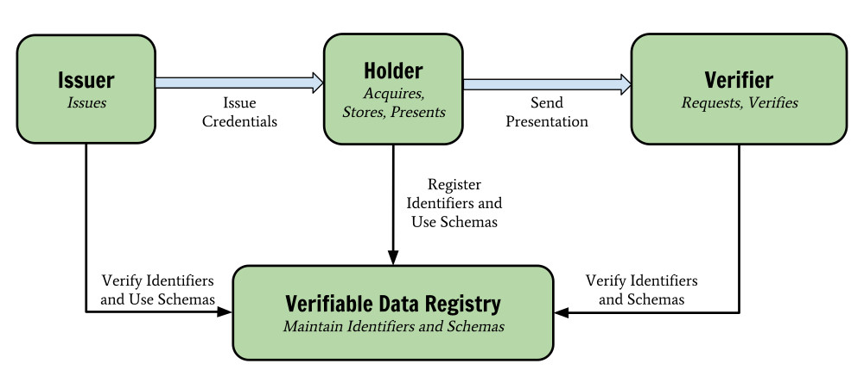
VC Data Model Components
https://www.w3.org/TR/vc-data-model/

Slide 27
VC Data Model Components
Holder - possesses one or more VC and generating verifiable presentations from them. Example holders include students, employees, and customers.​
​
Issuer –Asserts claims (in physical world) about one or more subjects, creating a VC from these claims, and transmitting the VC to a holder. Example issuers include universities, governments, etc.​
Subject - Entity about which claims are made. Example subjects include human beings, animals, and things.
Holder of a VC might not be the subject - example, a parent (the holder) might hold the verifiable credentials of a child (the subject), or a pet owner (the holder) might hold the verifiable credentials of their pet (the subject). Note: some credentials might even be self-certified by the subject
Verifier – Receives verifiable presentation to assert claims about subject. Example verifiers include employers, security personnel, and websites.
Verifiable data registry - System for creation and verification of DID, keys, and other relevant data, such as VC schemas, revocation registries, issuer public keys, and so on.
https://www.w3.org/TR/vc-data-model/

Slide 28
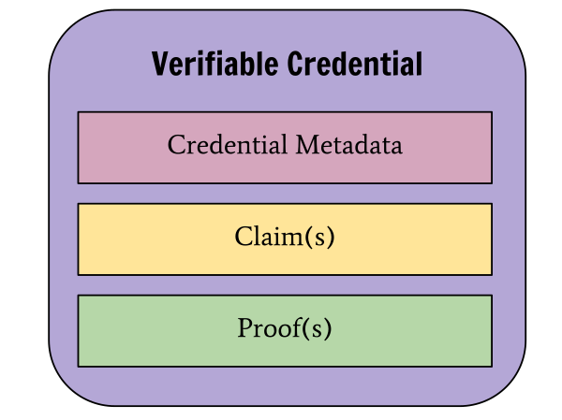
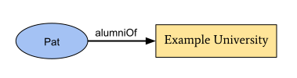
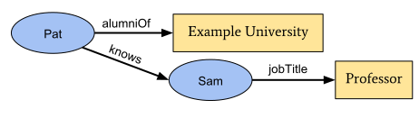
VC Data
Claims
A credential is a set of one or more claims made by the same entity.
Proof is usually signature by the issuer
A claim is a statement about a subject.
Here Pat and Sam are subjects.
https://www.w3.org/TR/vc-data-model/

Slide 29
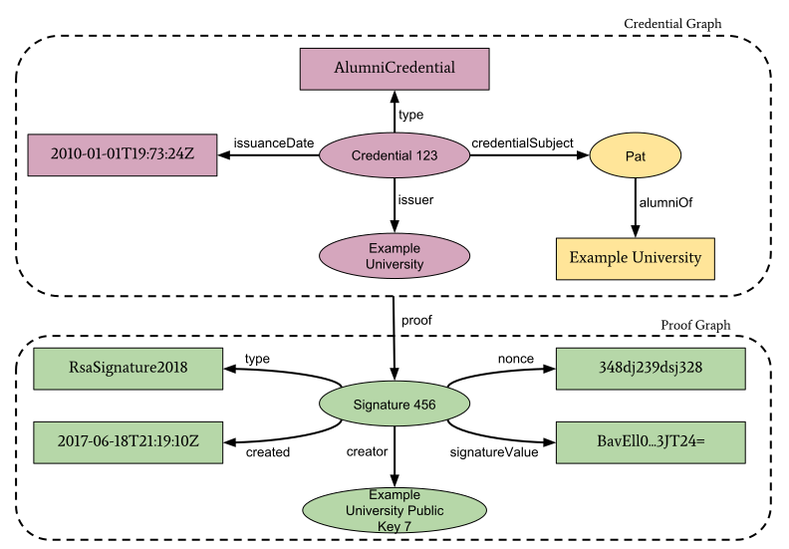
Information graph of a basic Verifiable Credential
These two together are effectively forming the verifiable credential for Pat
https://www.w3.org/TR/vc-data-model/

Slide 30
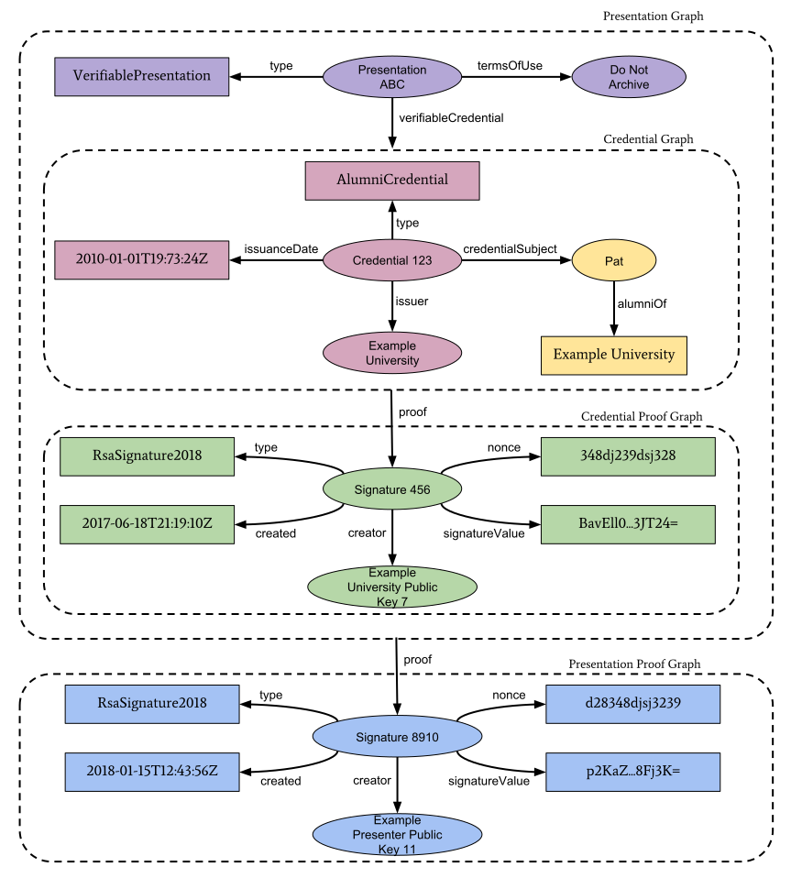
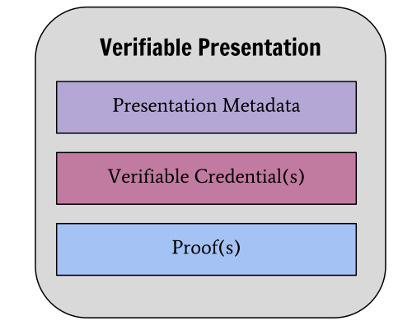
Information graph of Verifiable Presentation
A verifiable presentation expresses data from one or more VCs, and is packaged in such a way that the authorship of the data is verifiable. Holder has to convince that indeed the VC was issued to him
https://www.w3.org/TR/vc-data-model/

Slide 31
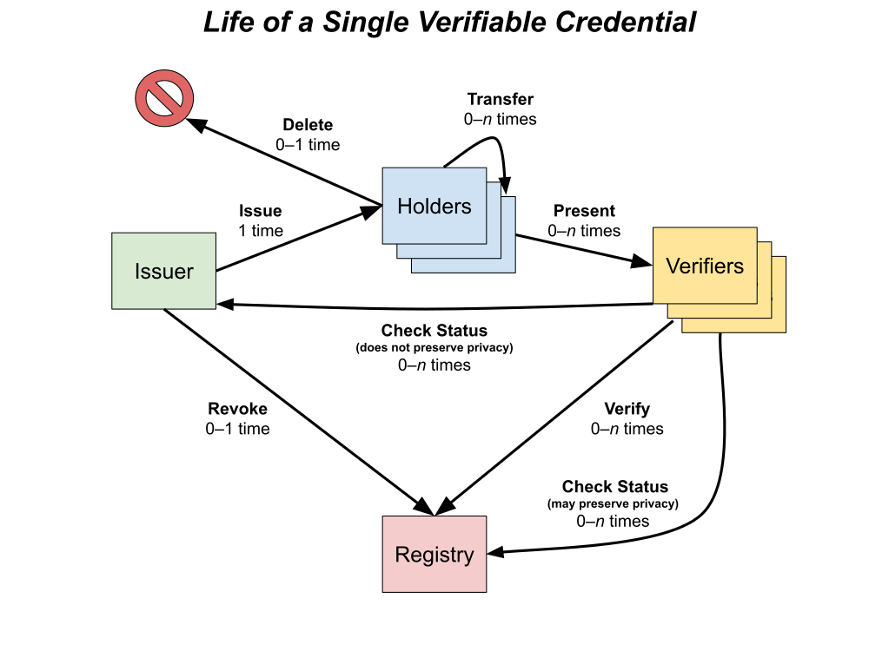
Verifiable Credentials Flow
https://www.w3.org/TR/vc-data-model/

Slide 32
VC Trust Model
Acting as issuer, holder, or verifier requires neither registration nor approval by any authority, as the trust involved is bilateral between parties.
Verifier trusts the issuer to issue the VC that it received. To establish this trust, a VC is expected to either:
  Include a proof establishing that the issuer generated the credential (signature), or
  VC has been transmitted in a way clearly establishing that the issuer generated VC is not tampered in transit or storage.
All entities trust the verifiable data registry to be tamper-evident and to be correct. Blockchain can help??
The holder and verifier trust the issuer to issue true (that is, not false) credentials about the subject, and to revoke them quickly when appropriate.
https://www.w3.org/TR/vc-data-model/

Slide 33
Combining DIDs and VCs
Step 1. Create and register DID
Verifiable Data Registry
1. Create and register DID Document
did:registry1:alice
Alice
did:registry1:university
University
DID Method Implementation

Slide 34
Combining DIDs and VCs
Step 2. Issue Verifiable Credential
Verifiable Data Registry
Alice
4. Alice authenticates as controller of did:registry1:alice
2. Alice Requests Transcript VC issued to did:registry1:alice
5. University issues Transcript VC
Holder: did:registry1:alice
Issuer: did:registry1:university
3. University fetch DID Document did:registry1:alice
University
DID Method Implementation

Slide 35

Combining DIDs and VCs
Step 3. Verifiable Presentation and Verification
Alice
7. Alice presents Transcript VP with signature authenticating did:registry1:alice
6. Industry requests Transcript VP
Verifiable Data Registry
8. Industry fetch did:registry1:university
8. Industry validates Transcript Issued to did:registry:alice
9. Industry validates issuer of Transcript by validating issuer's signature.
10. Ensure validity of identity by checking revocation lists
Industry
DID Method Implementation

Slide 36
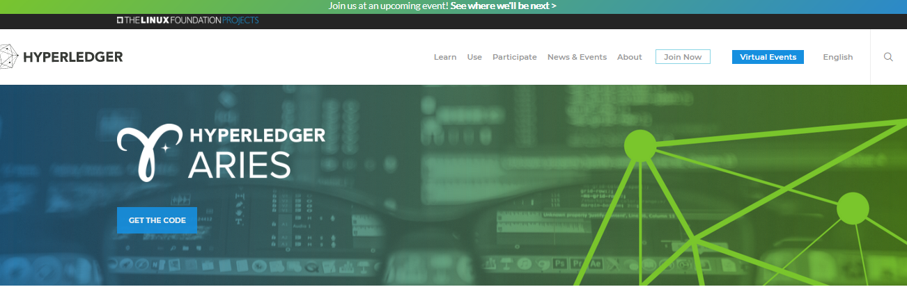
Use of Blockchain for VCs
Hyperledger Aries is meant for creating, transmitting and storing verifiable digital credentials

