Slide 1
CS61065: Theory and Applications of Blockchain
Basic Crypto Primitives - II
Shamik Sural
shamik@cse.iitkgp.ac.in

Slide 2
What We have Looked Into
Cryptographically Secured Hash Function
  Collision Free
  Information Hiding
  Puzzle Friendly
Hash Pointers and Data Structures
  Hashchain
  Hash Tree – Merkle Tree

Slide 3
Digital Signature
A digital code, which can be included with an electronically transmitted document to verify
  The content of the document is authenticated
  The identity of the sender
  Prevent non-repudiation – sender will not be able to deny about the origin of the document

Slide 4
Purpose of Digital Signature
Only the signing authority can sign a document, but everyone can verify the signature
Signature is associated with the particular document
  Signature of one document cannot be transferred to another document

Slide 5
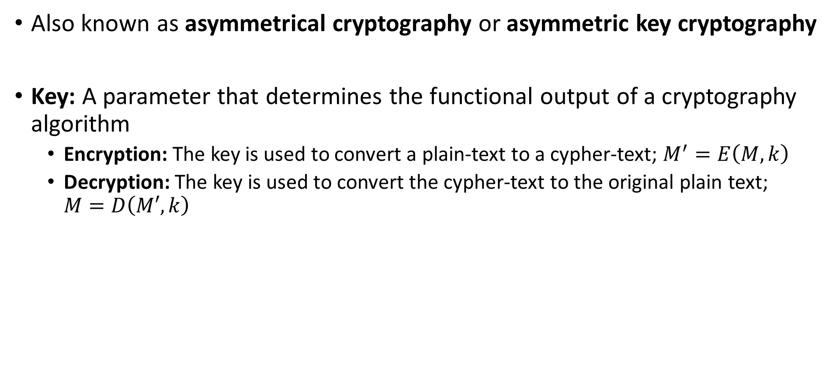
Public Key Cryptography
Also known as asymmetrical cryptography or asymmetric key cryptography
Key: A parameter that determines the functional output of a cryptography algorithm
  Encryption: The key is used to convert a plain-text to a cypher-text; $M^{′}=E\left(M,k\right)$
  Decryption: The key is used to convert the cypher-text to the original plain text; $M=D\left(M′,k\right)$

Slide 6
Public Key Cryptography
Properties of a cryptographic key (you need to prevent it from being guessed)
  Generate the key truly randomly so that the attacker cannot guess it
  The key should be of sufficient length – increasing the length makes the key difficult to guess
  The key should contain sufficient entropy, all the bits in the key should be equally random

Slide 7
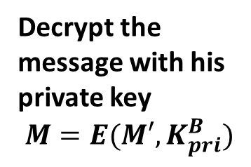
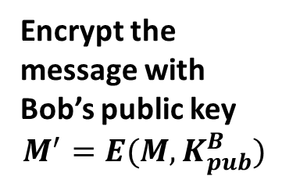
Public Key Cryptography
Two keys are used
  Private key: Only Alice has her private key
  Public key: “Public” to everyone – everyone knows Alice’s public key
Encrypt the message with Bob’s public key
$$M^{′}=E(M,K_{pub}^{B})$$
Decrypt the message with his private key
$$M=E(M′,K_{pri}^{B})$$
M’

Slide 8
Public Key Encryption - RSA
Named over (Ron) Rivest – (Adi) Shamir – (Leonard) Adleman – inventors of the public key cryptosystem
The encryption key is public and decryption key is kept secret (private key)
  Anyone can encrypt the data
  Only the intended receiver can decrypt the data

Slide 9
RSA Algorithm
Four phases
  Key generation
  Key distribution
  Encryption
  Decryption
Image source: https://commons.wikimedia.org/

Slide 10
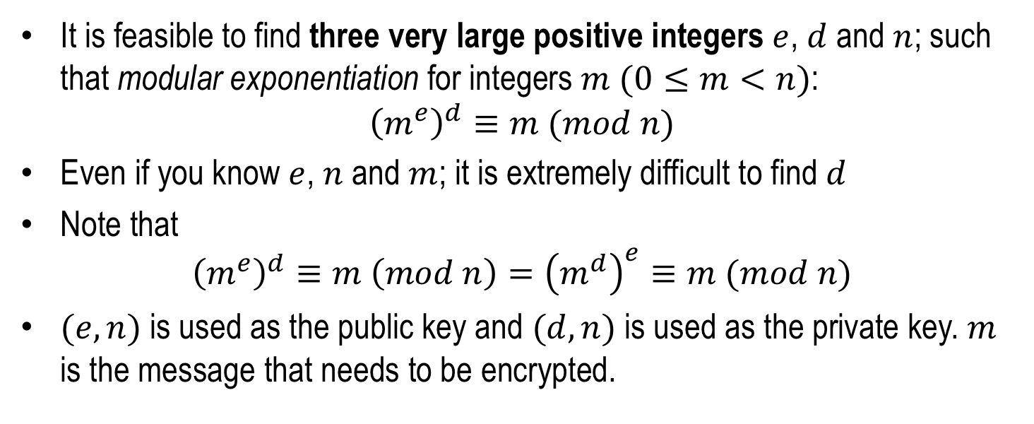
Public and Private Keys in RSA
It is feasible to find three very large positive integers $e$, $d$ and $n$; such that modular exponentiation for integers $m$ $(0≤m<n)$:
$${\left(m^{e}\right)}^{d}≡m (mod n)$$
Even if you know $e$, $n$ and $m$; it is extremely difficult to find $d$
Note that
$${\left(m^{e}\right)}^{d}≡m \left(mod n\right)={\left(m^{d}\right)}^{e}≡m (mod n)$$
$(e,n)$ is used as the public key and $(d,n)$ is used as the private key. $m$ is the message that needs to be encrypted.

Slide 11
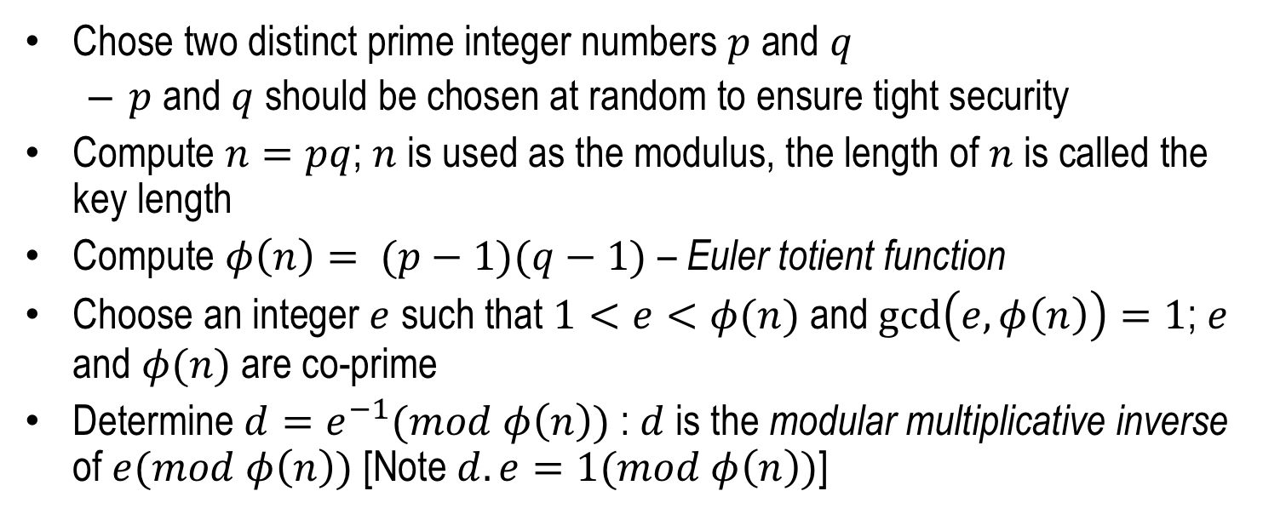
RSA Key Generation and Distribution
Chose two distinct prime integer numbers $p$ and $q$
  $p$ and $q$ should be chosen at random to ensure tight security
Compute $n=pq$; $n$ is used as the modulus, the length of $n$ is called the key length
Compute $φ\left(n\right)= (p−1)(q−1)$ – Euler totient function
Choose an integer $e$ such that $1<e<φ(n)$ and $\gcd\left(e,φ\left(n\right)\right)=1$; $e$ and $φ(n)$ are co-prime
Determine $d=e^{−1}(mod φ\left(n\right))$ : $d$ is the modular multiplicative inverse of $e(mod φ\left(n\right))$ [Note $d.e=1(mod φ\left(n\right))$]

Slide 12
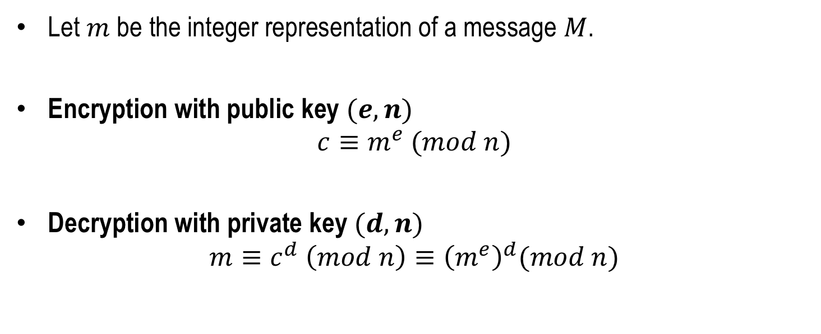
RSA Encryption and Decryption
Let $m$ be the integer representation of a message $M$.
Encryption with public key $(e,n)$
$$c≡m^{e} (mod n)$$
Decryption with private key $(d,n)$
$$m≡c^{d} \left(mod n\right)≡{\left(m^{e}\right)}^{d}(mod n)$$

Slide 13
RSA Encryption and Decryption - Example
Key Selection
Select 2 prime numbers: p=17, q=11
Calculate n=pq=17×11=187
Calculate φ(n)=(p-1)(q-1)=16×10=160
Select e such that e is relatively prime to φ(n)=160 and less than φ(n); Let e=7
Determine d such that d.e ≡ 1 mod 160 and d<160; Can determine d = 23 since 23×7 = 161 = 1×160+1
Encryption of Plaintext M = 88
C=88⁷ mod 187
= [(88⁴ mod 187)×(88² mod 187)×(88¹ mod 187)] mod 187 = (88×77×132) mod 187 = 11
Decryption of Ciphertext C = 11
M=11²³ mod 187
=[(11¹ mod 187)×(11² mod 187) ×(11⁴ mod 187) ×(11⁸ mod 187) ×(11⁸ mod 187)] mod 187
=(11×121×55×33×33) mod 187 = (79720245) mod 187 = 88
Courtesy: Cryptography and Network Security by William Stallings

Slide 14
RSA Encryption and Decryption - Demo
https://www.devglan.com/online-tools/rsa-encryption-decryption

Slide 15
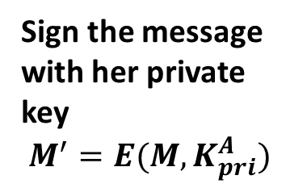
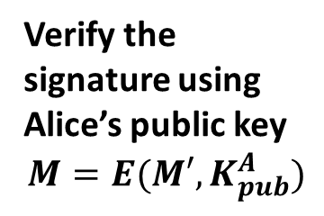
Digital Signature using Public Key Cryptography
Sign the message using the Private key
  Only Alice can know her private key
Verify the signature using the Public key
  Everyone has Alice’s public key and they can verify the signature
Sign the message with her private key
$$M^{′}=E(M,K_{pri}^{A})$$
Verify the signature using Alice’s public key
$$M=E(M′,K_{pub}^{A})$$
M, M’

Slide 16
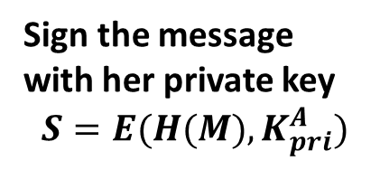
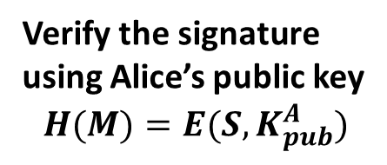
Reduce the Signature Size
Use the message digest to sign, instead of the original message
M, S
Sign the message with her private key
$$S=E(H(M),K_{pri}^{A})$$
Verify the signature using Alice’s public key
$$H(M)=E(S,K_{pub}^{A})$$

Slide 17
Digital Signature in Blockchain
Used to validate the origin of a transaction
  Prevent non-repudiation
    Alice cannot deny her own transactions
    No one else can claim Alice’s transaction as his/her own transaction
Bitcoin uses Elliptic Curve Digital Signature Algorithm (ECDSA)
  Based on elliptic curve cryptography
  Supports good randomness in key generation

Slide 18
A Cryptocurrency using Hashchain and Digital Signatures
A:10, Sig(A)
Alice generates 10 coins
Sign the transaction A:10 using Alice’s private key and put that in the blockchain

Slide 19
A Cryptocurrency using Hashchain and Digital Signatures
H(0)
H(1)
A:10, Sig(A)
A->B:5, Sig(A)
Alice transfers 5 coins to Bob
Sign the transaction A-B:5 using Alice’s private key and put that in the blockchain

Slide 20
A Cryptocurrency using Hashchain and Digital Signatures
Maintain the economy
  Generate new coins with time
  Delete old coins with time
A central authority like bank can create and destroy coins based on economic policies
Crucial Question: How can we distribute coin management (creation and destroy)

