Slide 1
Segmentation Oral-OSF image
Segmentation of the images
Analysis of the features of Oral Epithelium
Identification of potential precancerous lesions and conditions

Slide 2
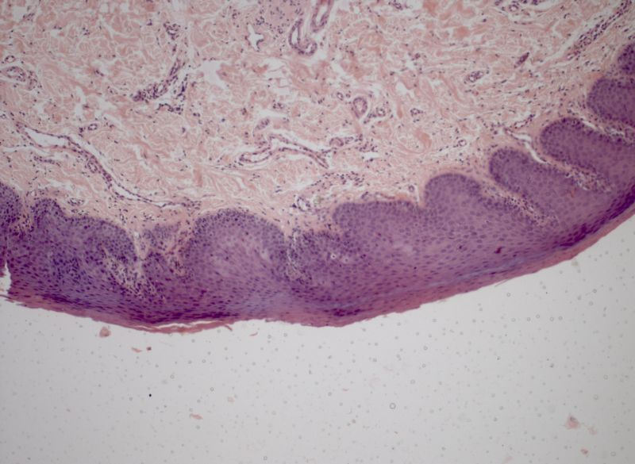
Original image

Slide 3
Segmentation using texture filter
Algorithm
color_img=imread('c.jpg');
gray_img=rgb2gray(color_img);
% Convert the rgb image into gray scale image

Slide 4
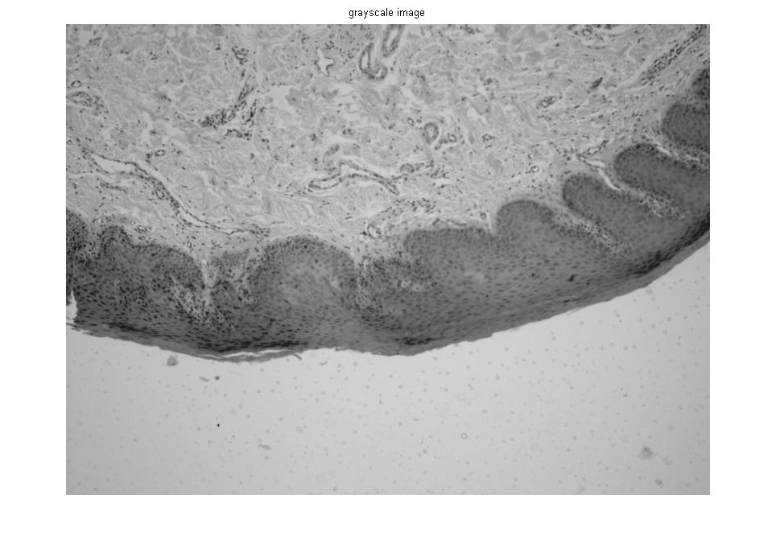

Slide 5
E = entropyfilt(gray_img);
Eim = mat2gray(E);
% The function entropyfilt returns an array where each output pixel contains the entropy value of the 9-by-9 neighborhood around the corresponding pixel in the input image.

Slide 6
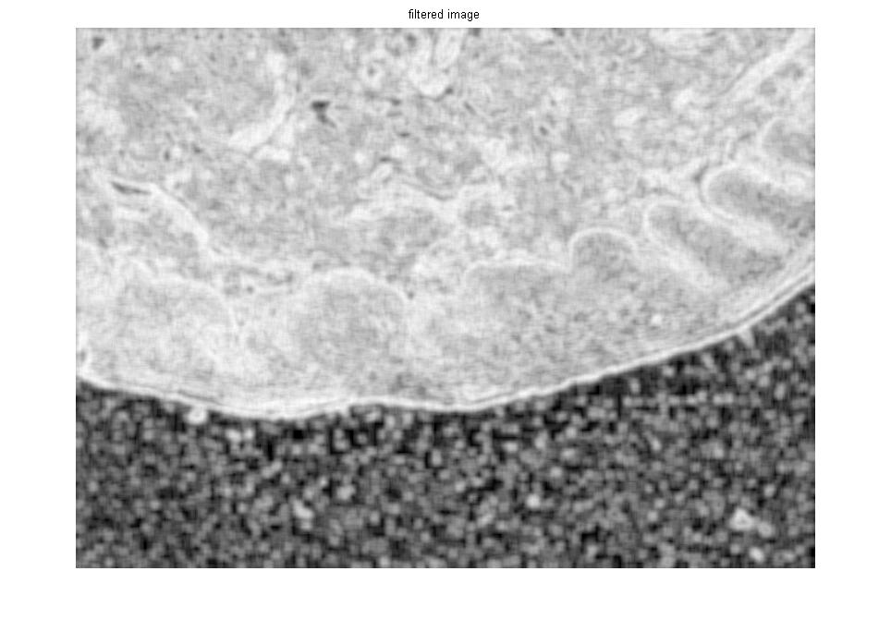

Slide 7
% Create a mask for the bottom texture
BW = im2bw(Eim, .6);

Slide 8
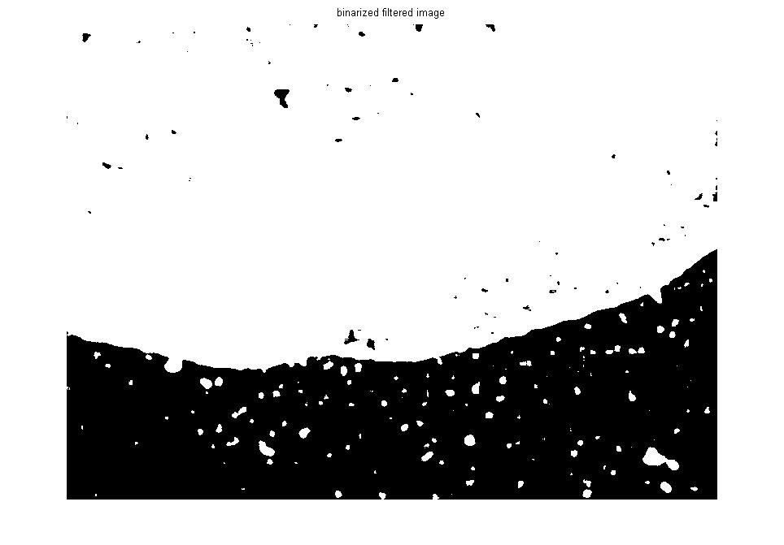

Slide 9
BWao = bwareaopen(BW,2000);
figure,imshow(BWao);
% removes the objects from the image whose total number of pixels is less than 2000.

Slide 10
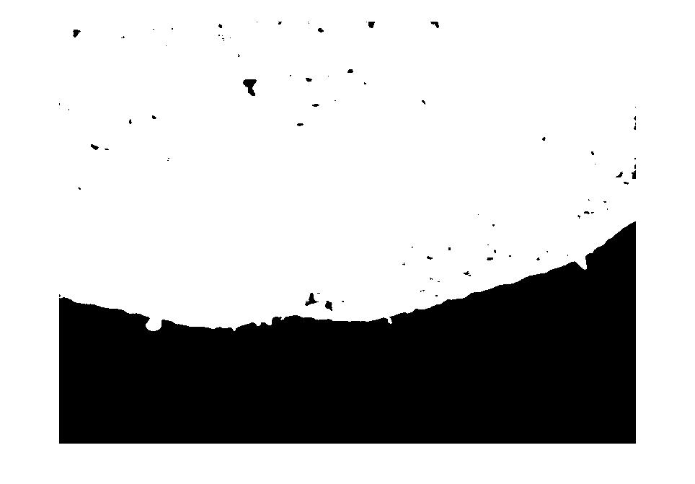

Slide 11
nhood = true(9);
closeBWao = imclose(BWao,nhood);
% imclose is used to smooth the edges and to close any open holes in the object in BWao.

Slide 12


Slide 13
roughMask = imfill(closeBWao,'holes');
% imfill to fill holes in the object in closeBWao

Slide 14


Slide 15
I = gray_img;
I(roughMask) = 0;
I2=gray_img-I;
% the final segmented image of the epithelial layer

Slide 16
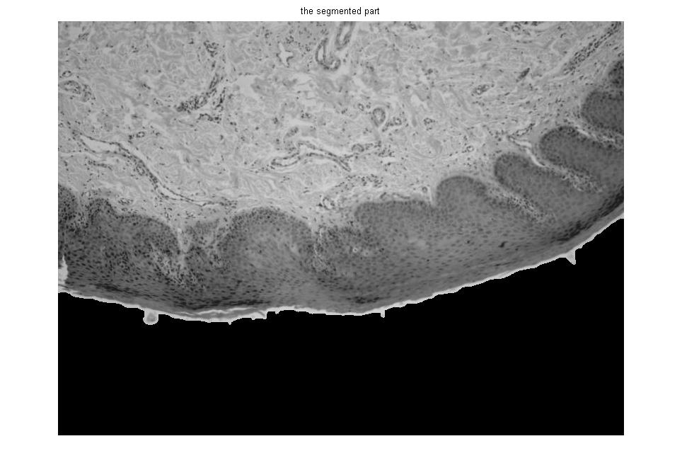

Slide 17
